Slide 1
Current state of information and modeling tools available to support an ecosystem approach to management
Sarah Gaichas
NEFSC Ecosystem Assessment Program
MAFMC Forage Workshop
April 11, 2013

Slide 2
Outline
Current state of ecosystem models and data
Bridges from single species → multispecies
Other approaches (e.g. functional groups)
Changes in the ecosystem
Information needs for forage species

Slide 3
Current state of ecosystem models and data
Able to support an ecosystem approach to management, and specifically forage management policy

Slide 4
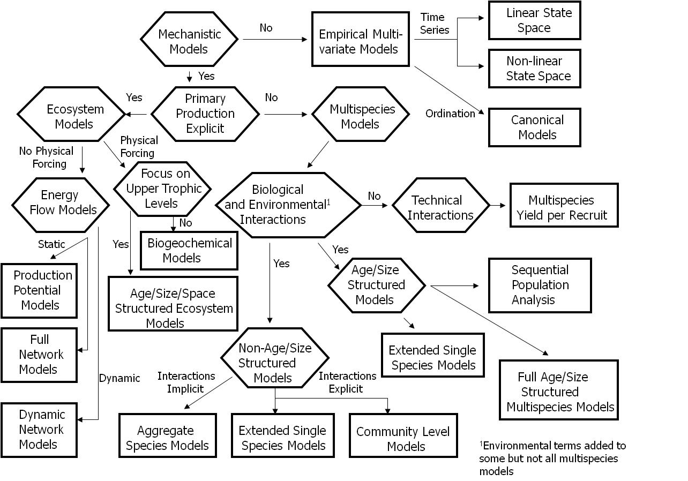

Slide 5
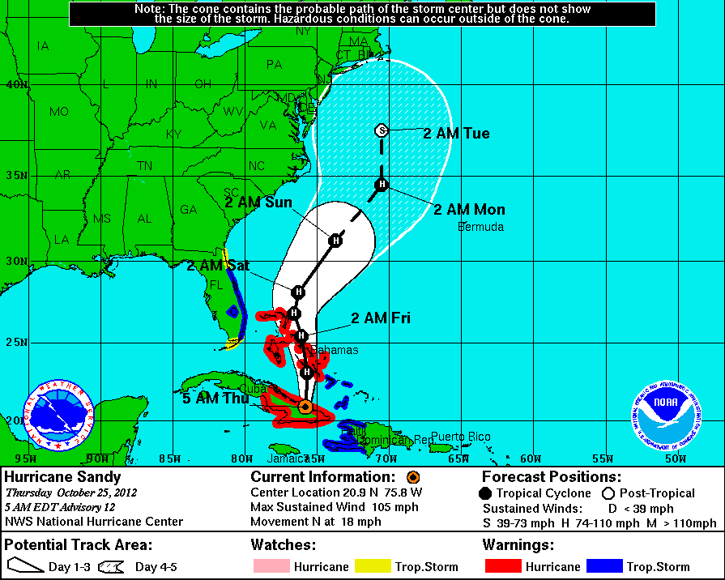
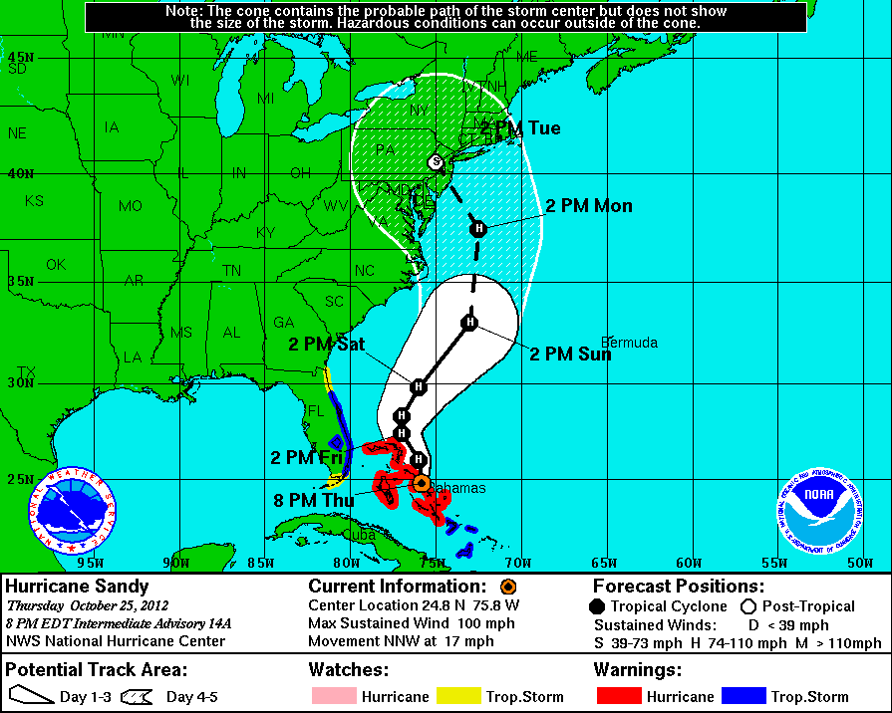
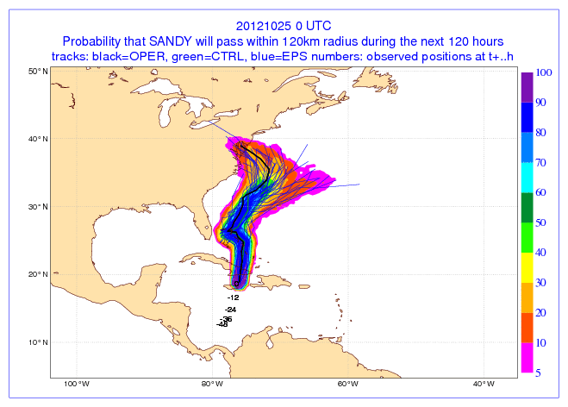
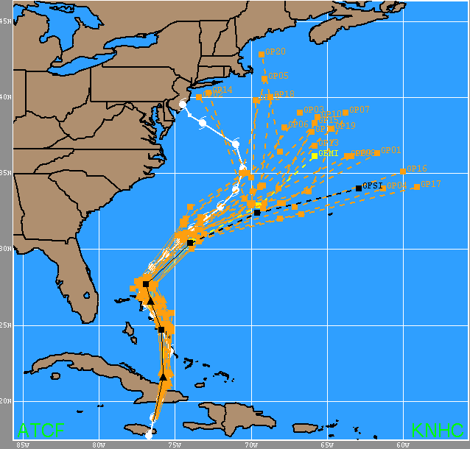
Multi Model Inference
More robust prediction
Analogous to climate models →
Model averaging available now
Methods established
  Qualitative: differently structured models giving similar results increase confidence. Can construct “envelope” for prediction.
  Quantitative: Bayesian, other ensemble methods

Slide 6
NEFSC Ecosystem Modeling Activities
Empirical Models (Nonlinear Time Series)
Ryther-Ware Production Potential Models
Aggregate Production Models
Multispecies Production Models
Size-Based Models
Ecosystem Network Models (Ecopath)
Multispecies Virtual Population Analysis
Full Ecosystem Models (Atlantis; Ecosim)
Complexity

Slide 7
NEFSC Ecosystem Modeling Activities
Empirical Models (Nonlinear Time Series)
Ryther-Ware Production Potential Models
Aggregate Production Models
Multispecies Production Models
Size-Based Models
Ecosystem Network Models (Ecopath)
Multispecies Virtual Population Analysis
Full Ecosystem Models (Atlantis; Ecosim)
Primary Assessment Models
Virtual Test Beds

Slide 8
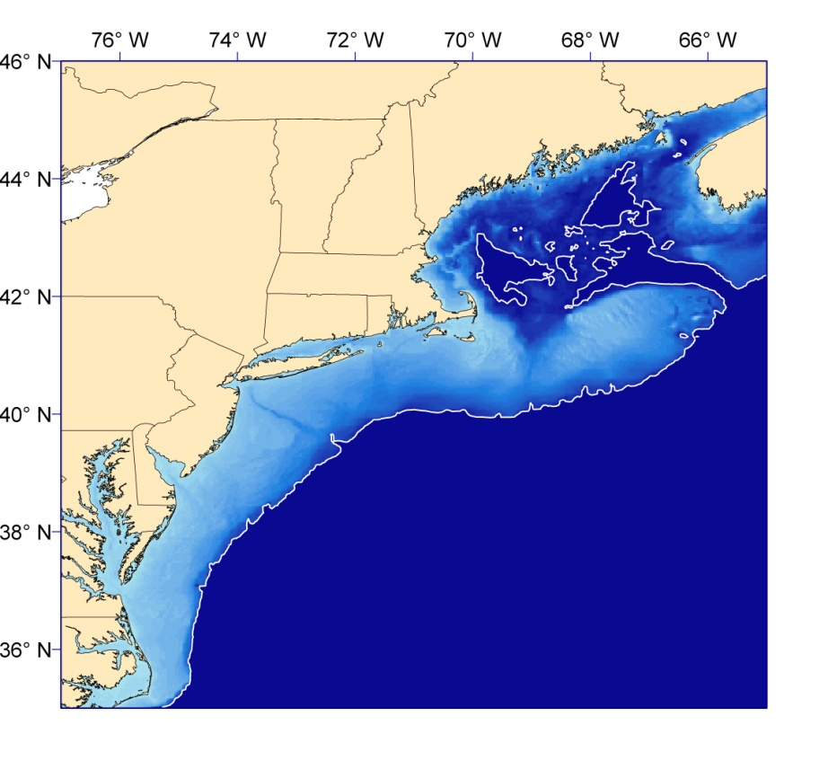
MS-PROD: Multispecies Production Model
Groundfish
Atlantic cod (GB)
Atlantic cod (GOM)
Haddock (GB)
Haddock (GOM)
Halibut
Ocean pout
Pollock
Redfish
White hake
American plaice
Windowpane (GOM-GB)
Windowpane (SNE)
Winter fldr (GB)
Winter fldr (GOM)
Winter fldr (SNE)
Witch flounder
Yellowtail (GOM)
Yellowtail (GB)
Yellowtail (SNE)
Gulf of
Maine
Georges
Bank
SNE
Middle Atlantic Bight
Elasmobranchs
Small pelagics
Skates and rays Atlantic herring
Spiny dogfish Butterfish
Mackerel
Gamble, R.J. and J.S. Link. 2009. Analyzing the tradeoffs among ecological and fishing effects on an example fish community: A multispecies (fisheries) production model. Ecol. Mod. 220: 2570-2582.
Notes:
Won’t say much more here than that is a multi-species extension of the Schaefer model with predation, interguild and intraguild competition terms.

Slide 9
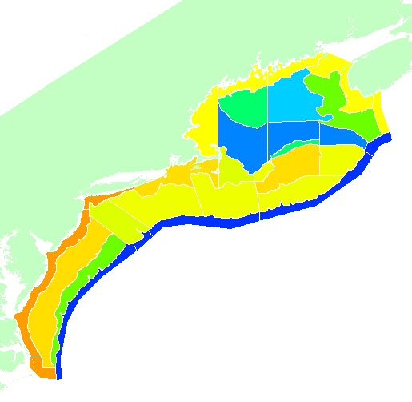
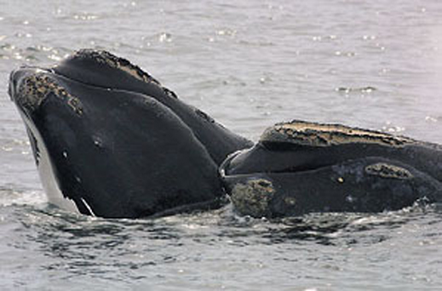

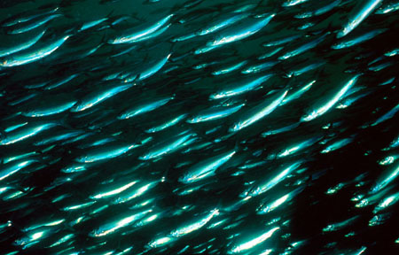
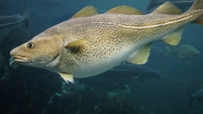
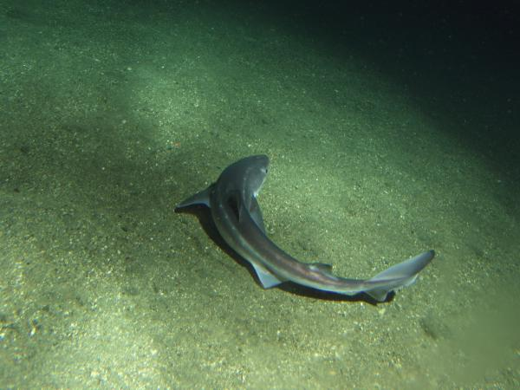
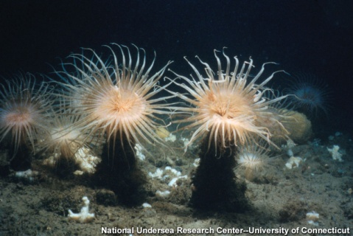
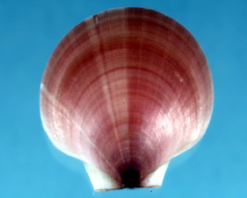
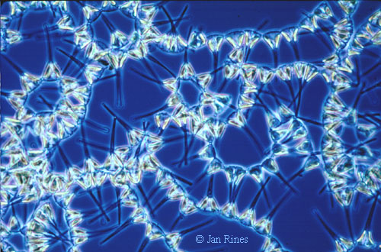
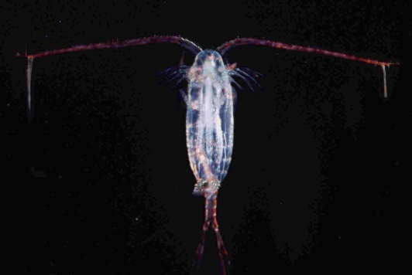
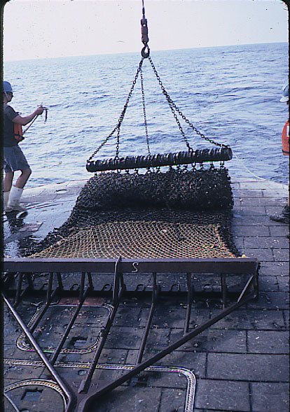
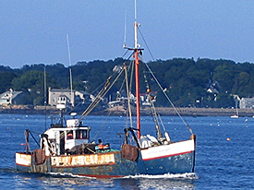
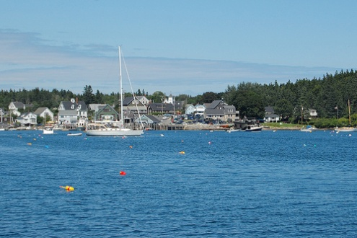
ATLANTIS Northeast US
Pelagic
45 Functional Groups
0
50
120+
300+
Epibenthic
Sediment
18 Fishing fleets
Link JS, Gamble RJ, Fulton EA. 2011. NEUS – Atlantis: Construction, Calibration, and Application of an Ecosystem Model with Ecological Interactions, Physiographic Conditions, and Fleet Behavior. NOAA Tech Memo NMFS NE-218 247 p. Available at http://www.nefsc.noaa.gov/nefsc/publications/.

Slide 10
ATLANTIS General Description (Beth Fulton, CSIRO)
Manager Roles
Simulation Cycle
DEFINE
OBJECTIVES
Industry
Biophysical
Monitoring
PERFORMANCE
MEASURES
Implementation
Assessment
Management

Slide 11
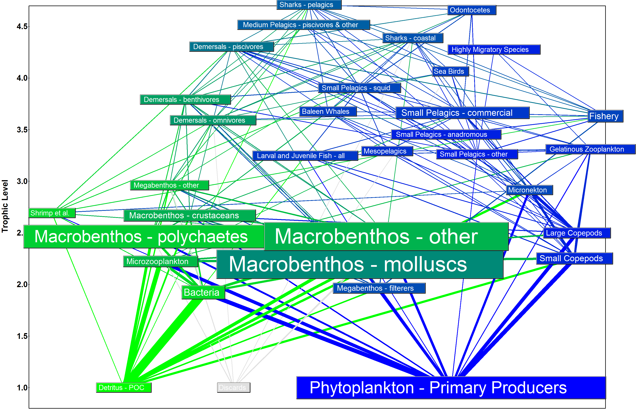

Slide 12
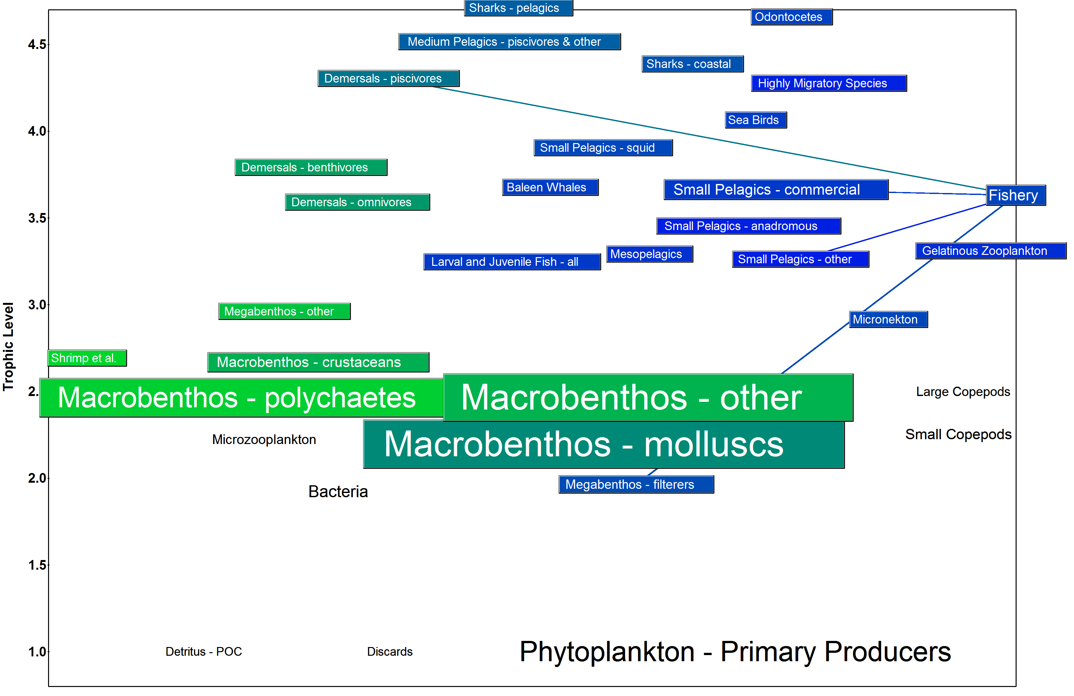

Slide 13
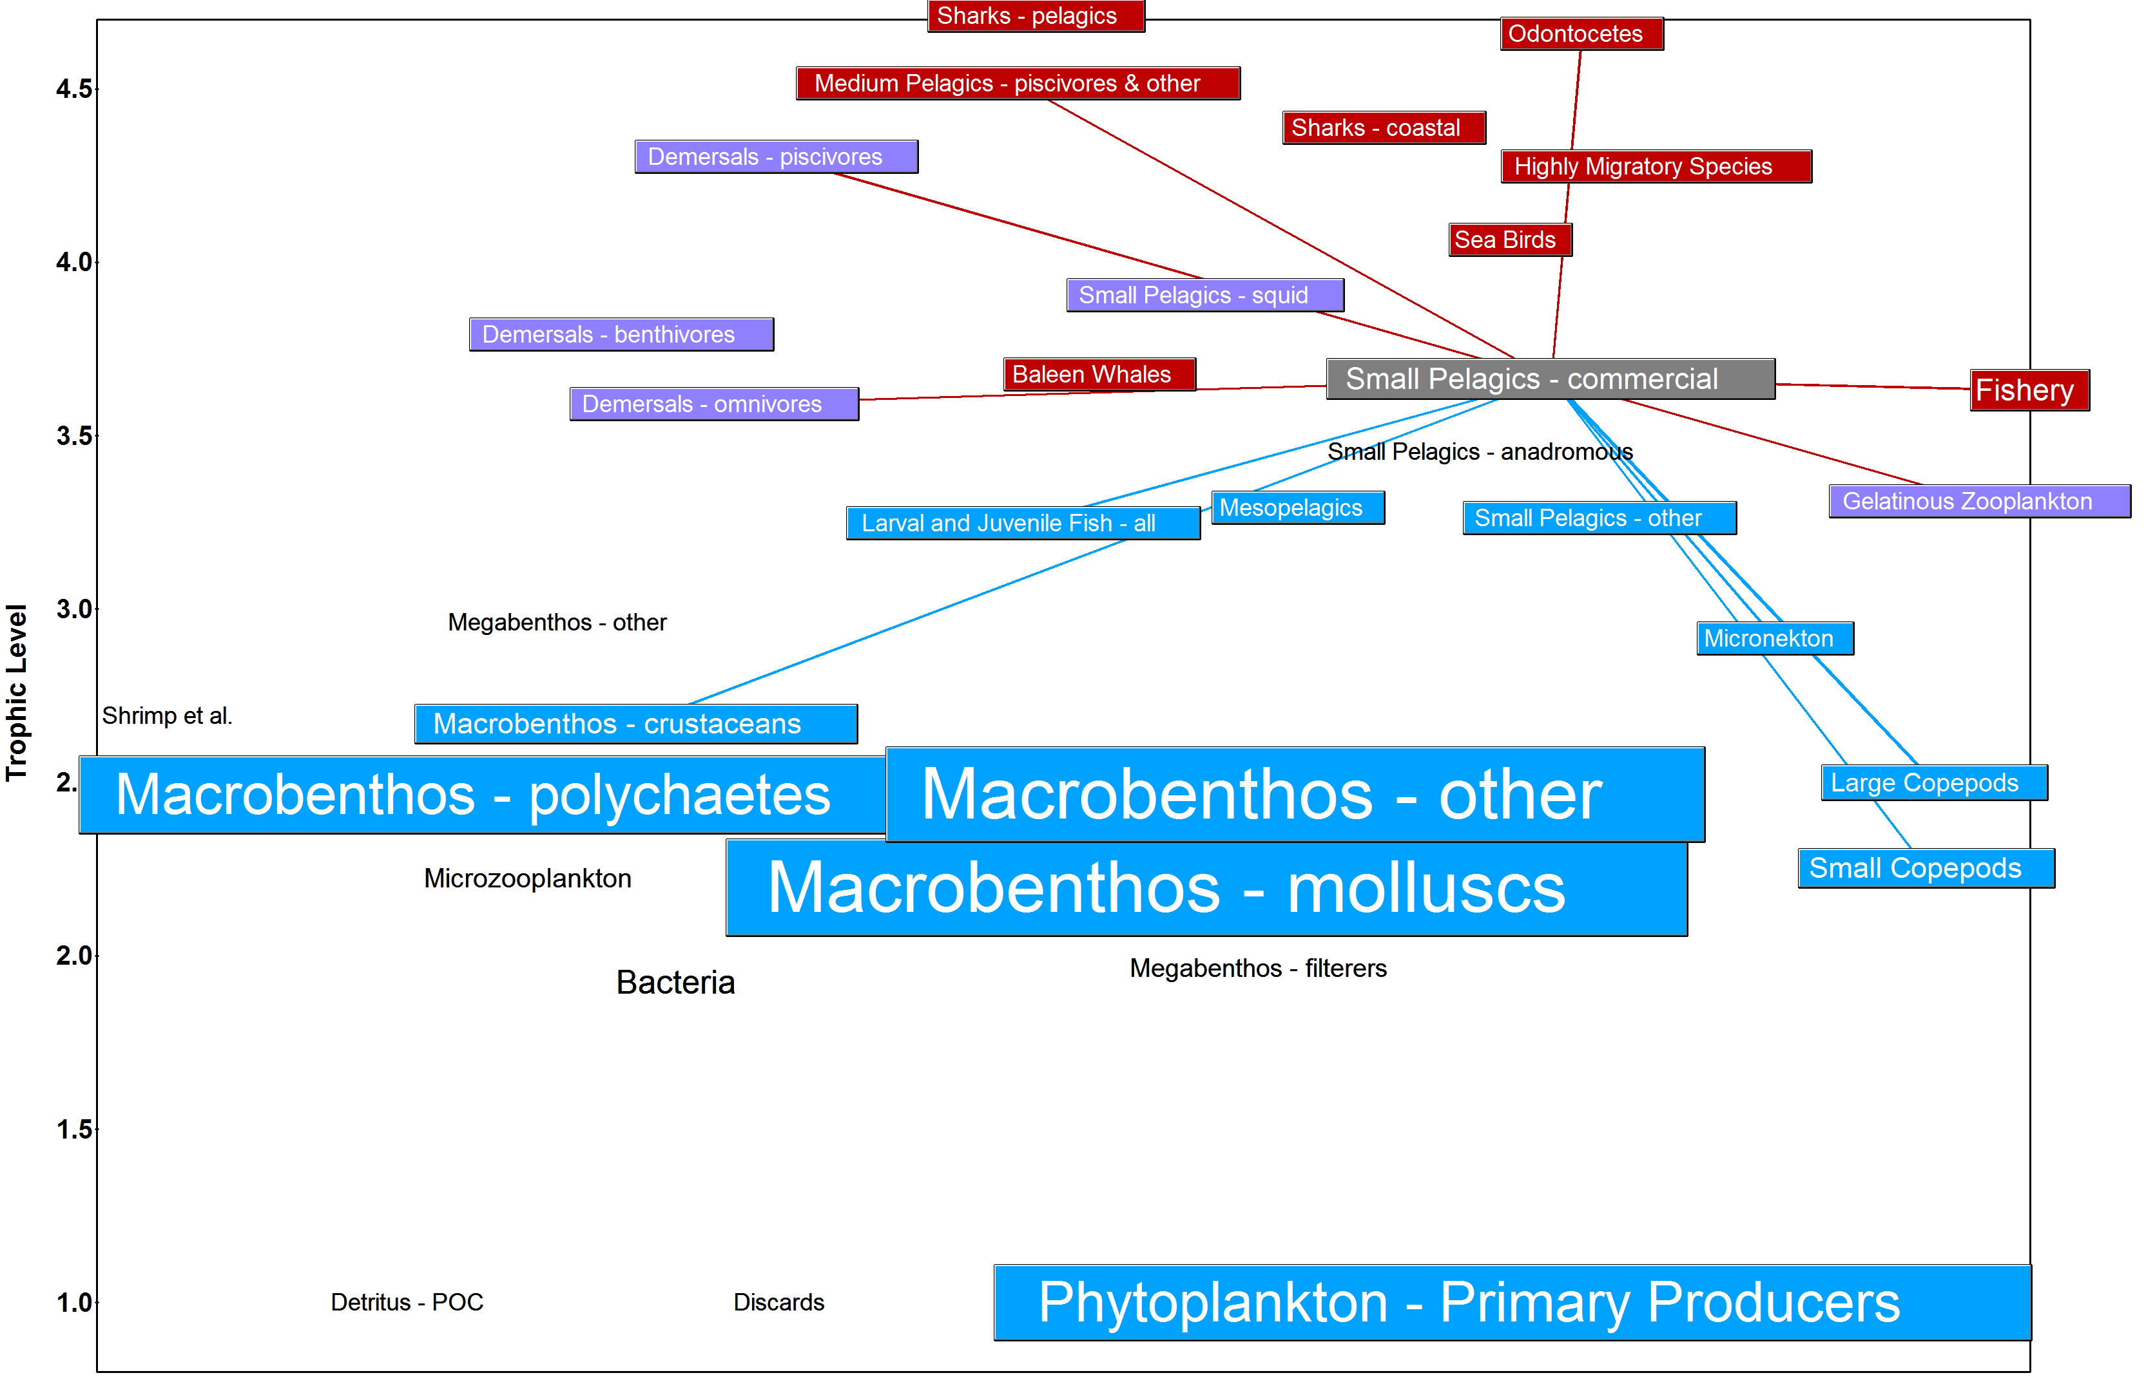

Slide 14
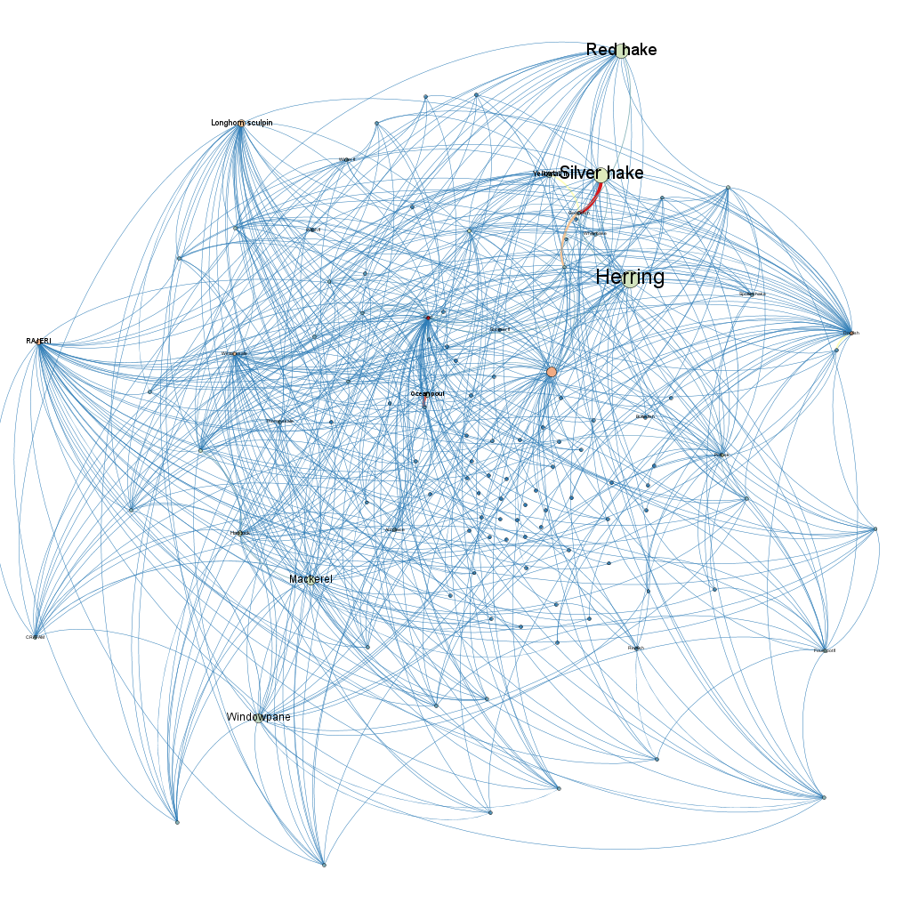
Northeast Shelf

Slide 15
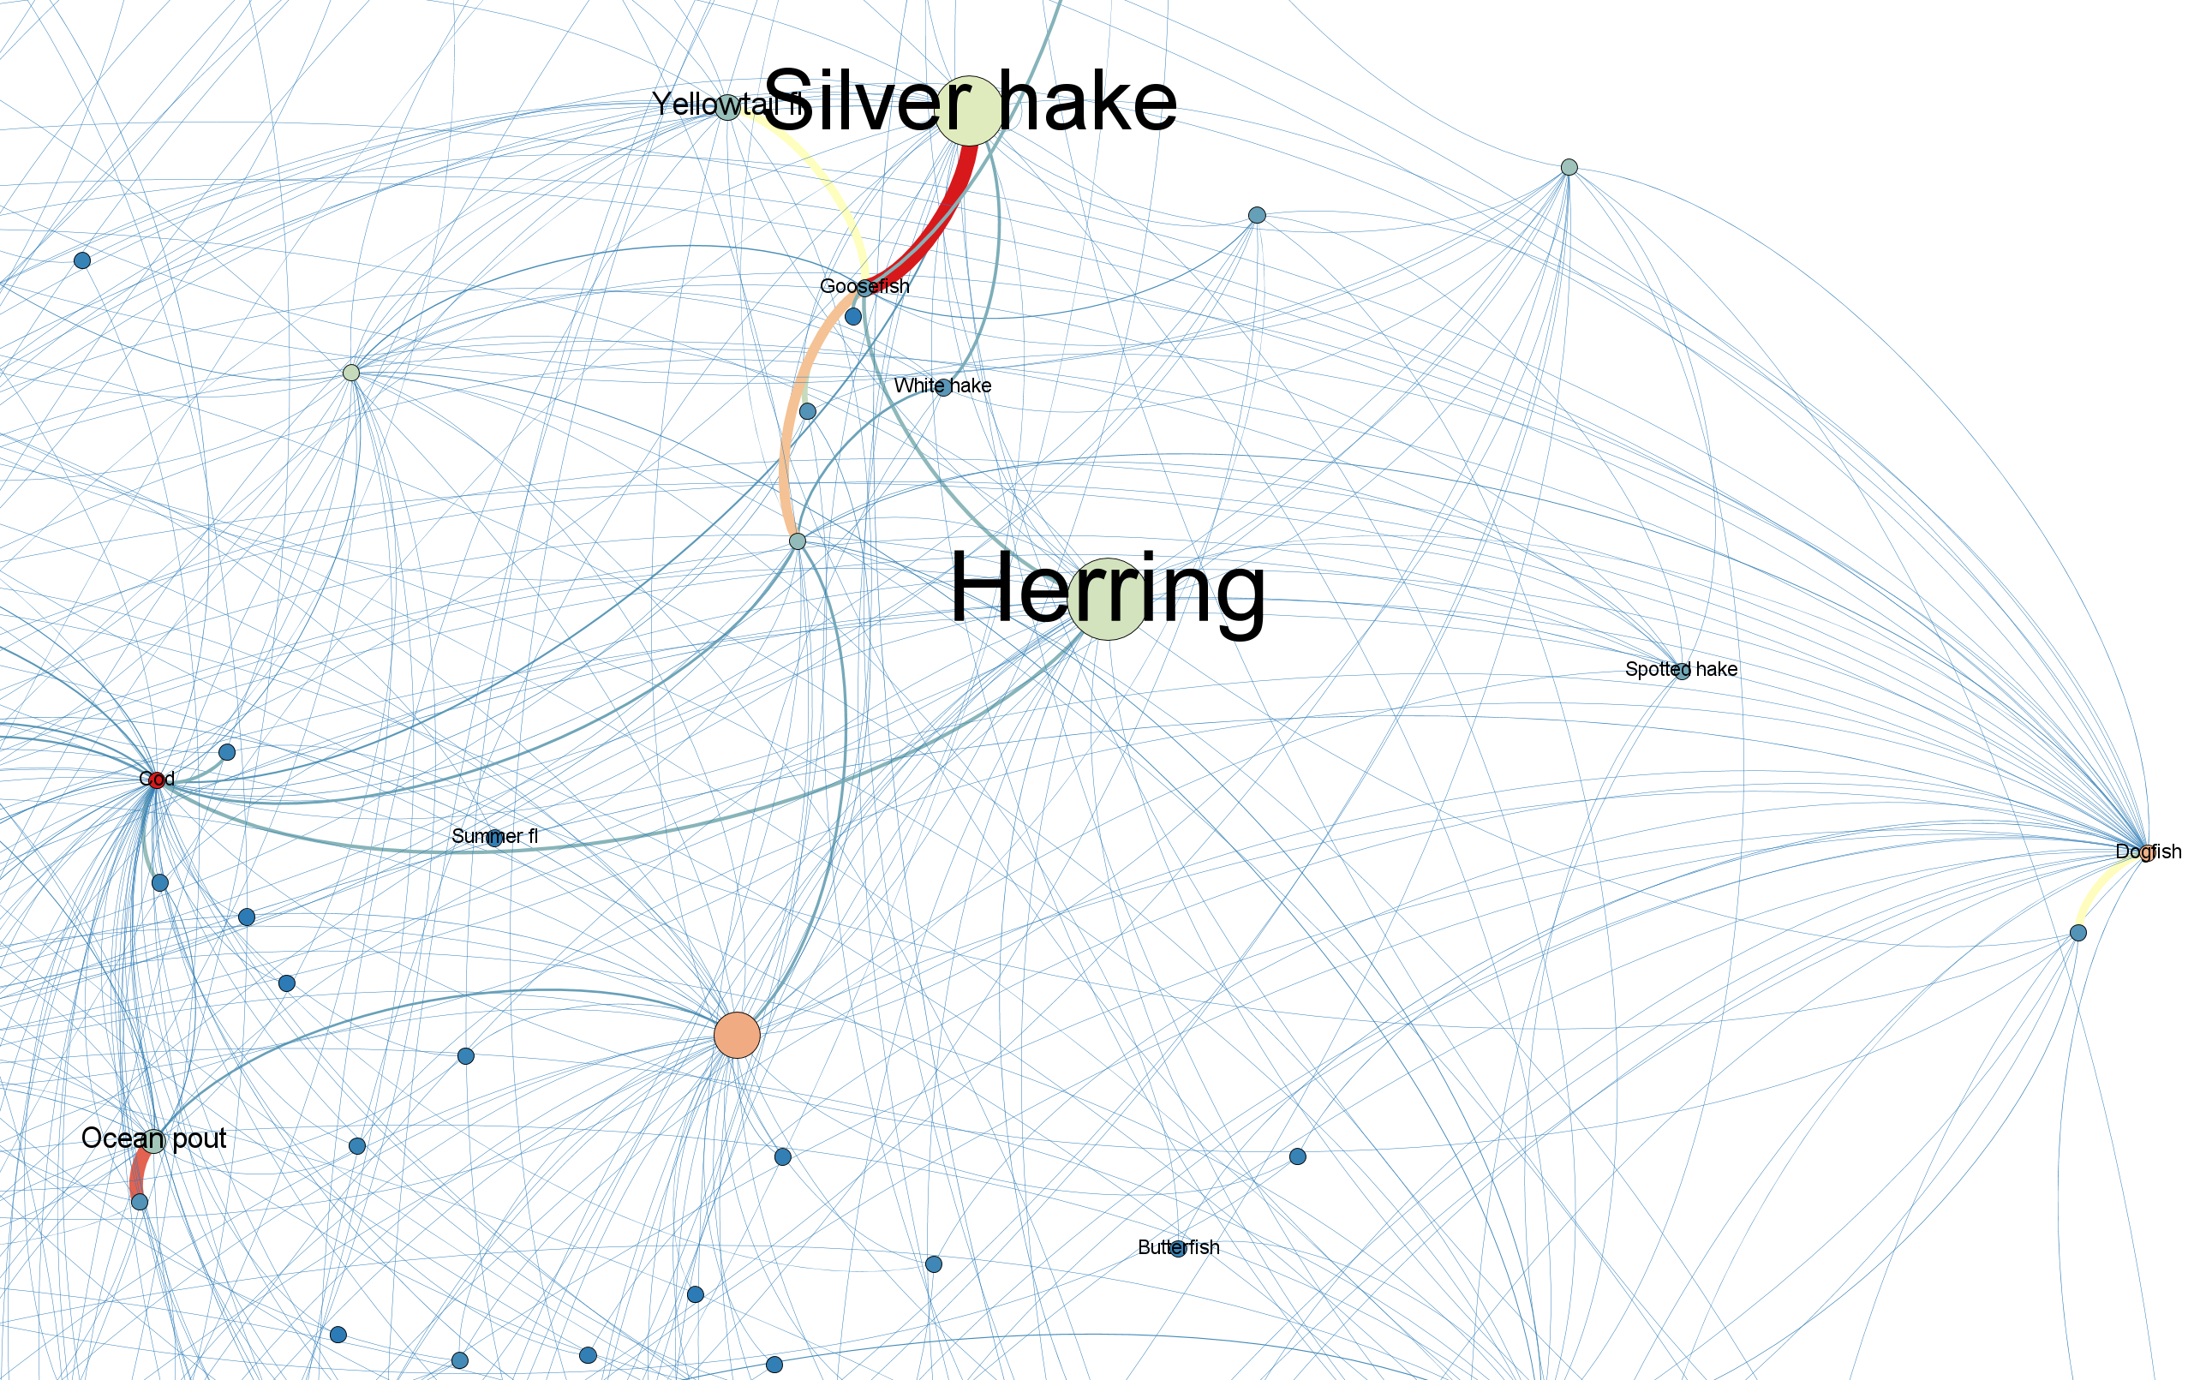

Slide 16
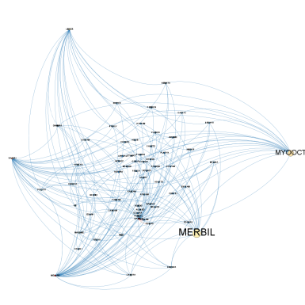
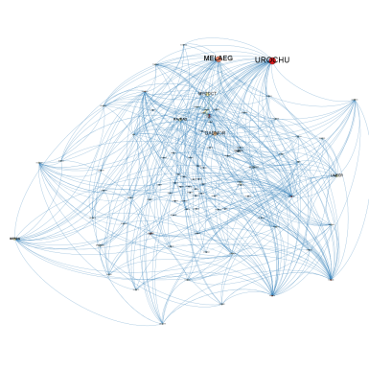
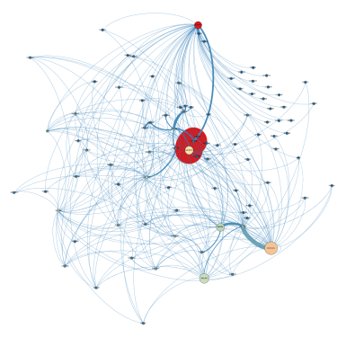
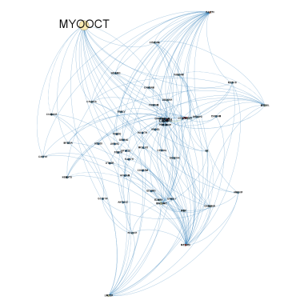
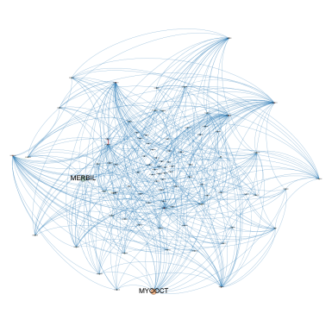
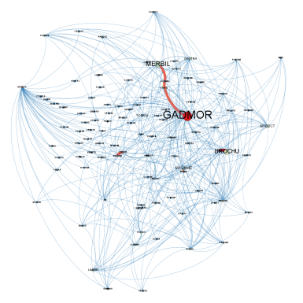
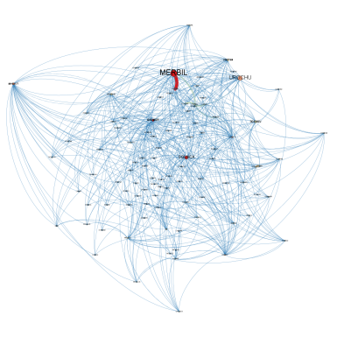
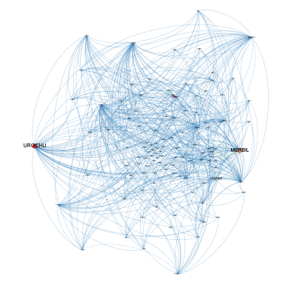
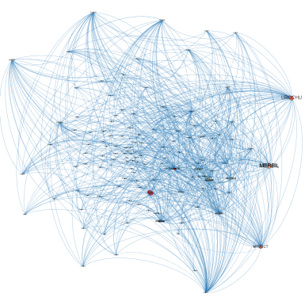
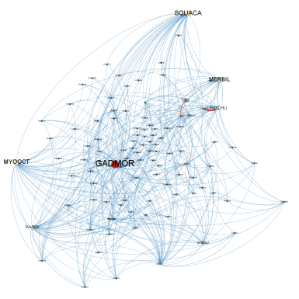
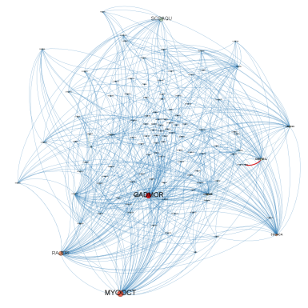
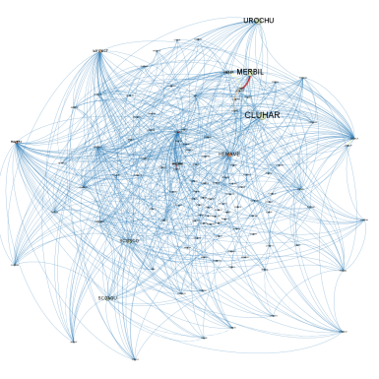
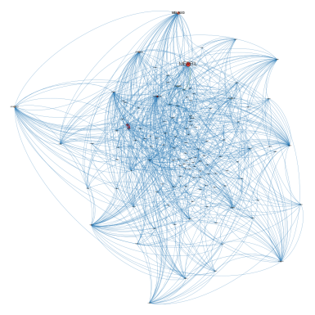
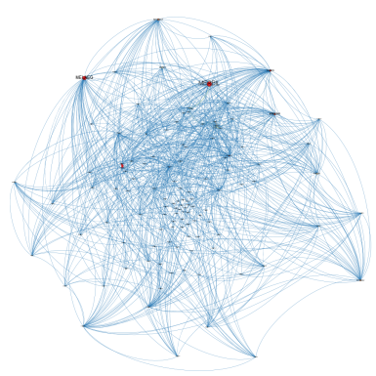
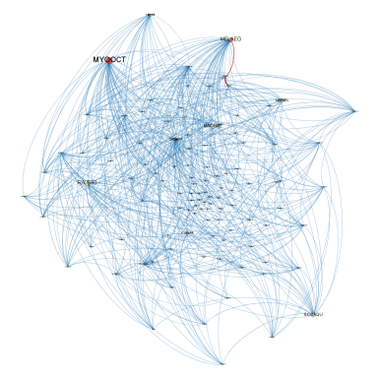
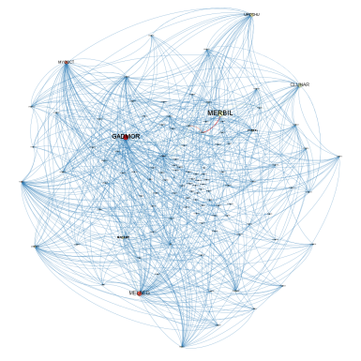
Changes from 40+ Years data
Spring and Fall each year

Slide 17
Bridges from single species → multispecies
Including species interactions to support forage management

Slide 18
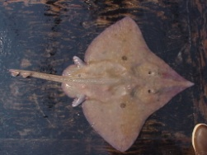
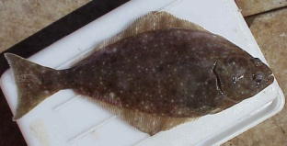
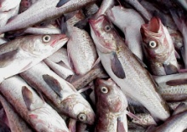
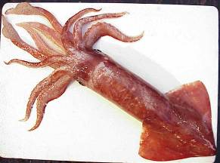
Food web models partition mortality
If Pred > F,
Re-evaluate constant M
Pred
Proportion of total mortality
F
Gaichas et al. 2010

Slide 19
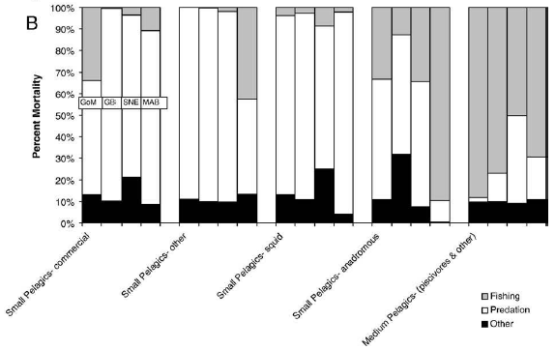
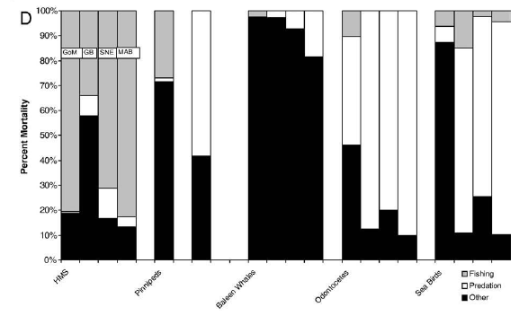
Fishing
Predation
Other
Link et al. 2008. The Northeast U.S. continental shelf Energy Modeling and Analysis exercise (EMAX): Ecological network model development and basic ecosystem metrics. Journal of Marine Systems 74: 453-474

Slide 20
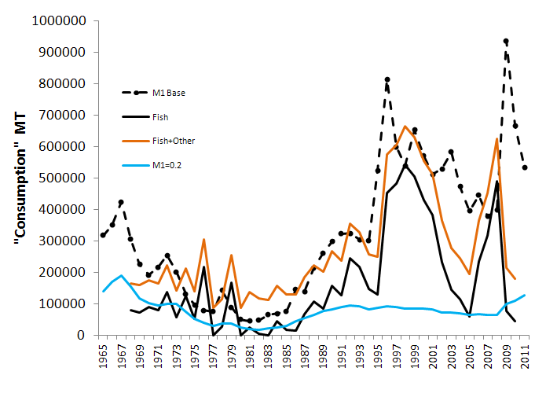
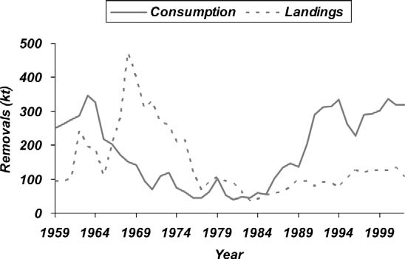
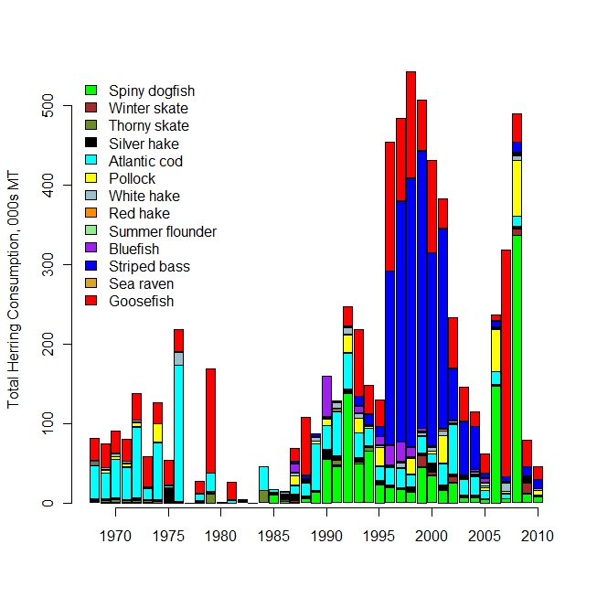
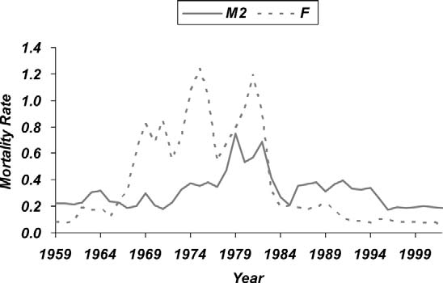
Predation in herring assessments
Deroba et al. 2012
Overholtz et al. 2008

Slide 21
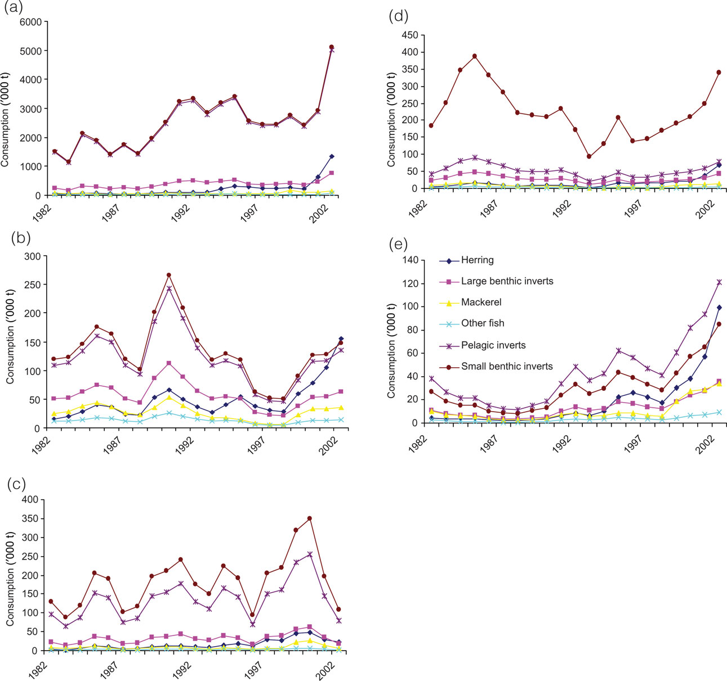

Predation in multispecies models
Consumption by dogfish
Mortality of herring
Mortality of mackerel
Consumption by silver hake
Tyrell et al. 2008

Slide 22
An intermediate-complexity tactical ecosystem assessment tool combines:
Standard stock assessment
Ecosystem considerations
Structured population dynamics
Statistical parameter estimation using multiple data sources
Biological reference points and stock status for management
Species interactions and tradeoffs
Environmental effects on key population processes
Populations and fisheries in space
… WITHOUT requiring time machines, expensive new surveys, or supercomputers

Slide 23


The new model (codename Hydra)
Multispecies: fish and commercial invertebrates
Estimates predation mortality
Spatial
Size structured
Reproductive biology emphasis
Environmental covariates on growth, maturity, fecundity
Likelihood (or Bayesian) parameter estimation in ADMB

Slide 24
Other approaches
Management at the level of functional groups

Slide 25
Comparative ecosystem modeling
Compare a triad of drivers across ecosystems of Canada, Norway and the US (CAMEO)
Use production modeling, applied at multiple levels of organization, as the unifying tool to serve as a comparative framework
What are appropriate species aggregations balancing yield and conservation objectives?
Exploitation
Fisheries Production
Trophodynamics
Biophysical
Marine Ecology Progress Series (MEPS) Theme Section, 459 (2012)
Notes:
25

Slide 26



Simulations: balancing objectives
Yield maximizing biodiversity is ~95% of MMSY
Gaichas et al. MEPS 459 (2012)

Slide 27
Georges Bank
proportion of MSY obtainable with no species below 25% Dark bars are 1.0
Gulf of Alaska

Slide 28
Changes in the ecosystem
Do they alter the ability to meet objectives or limit future options?

Slide 29

Observed sea surface temperature trend
Courtesy Michael Alexander (NOAA/ESRL/PSD), Jamie Scott (CIRES), and Antonietta Capotondi (CIRES)

Slide 30



Fish communities

Slide 31
Information needs for forage species
And two main questions to address

Slide 32
List of data and analyses needed
Improved consumption information
  Quantification of uncertainty: standardize methods
  Diet for upper trophic level predators (mammals, birds, HMS)
Parameterize existing models for specific mid-Atlantic issues, species, and regional environments
Alternative management objectives/strategies for testing
Risk analysis to determine where highest priority gaps remain
Notes:
Integrate habitat, behavioral ecology info to predict response to environmental change (e.g., migratory or range shifts)
Analyze potential changes in growth, reproductive rates
Examine survey and catch at multiple spatial/temporal scales
Economic data to evaluate tradeoffs between options

Slide 33
Two main questions
How to include predation in forage fish management?
  Within single species assessments
  Using multispecies assessments
  As an adjustment to policy (OFL, buffers, etc.)
How to account for tradeoffs in predator consumption requirements when managing forage fish?
  Possible with current data, multispecies models
  Managing tradeoffs a new level of policy

