Slide 1
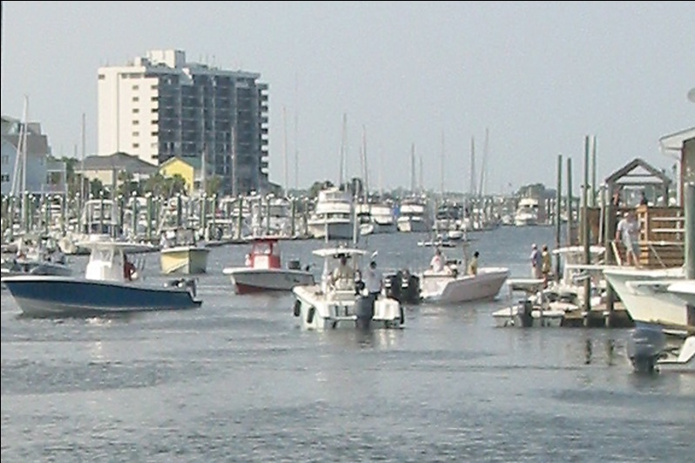
Pilot Project: Estimating total tournament harvest with voluntary text reporting
M. Scott Baker Jr.
Fisheries Specialist
NC Sea Grant
bakers@uncw.edu
MRIP Volunteer Angler Data Workshop
Feb 2, 2012
Notes:
Thanks for the invitation to be a part of this workshop. I think this is a great concept to explore and I’m happy to share my experiences and perspective on this topic. I have recently led a couple of self-reporting pilot studies that focused on the evaluation of new technology usage in surveys – and voluntary data collection of segments of the fishery not traditioanlly sampled by MRIP – tournament catch and effort. I would like to share some brief highlights from those studies as well as provide my opinion on some topics that will inevitably be discussed with regard to future study design regarding mobile technology.

Slide 2
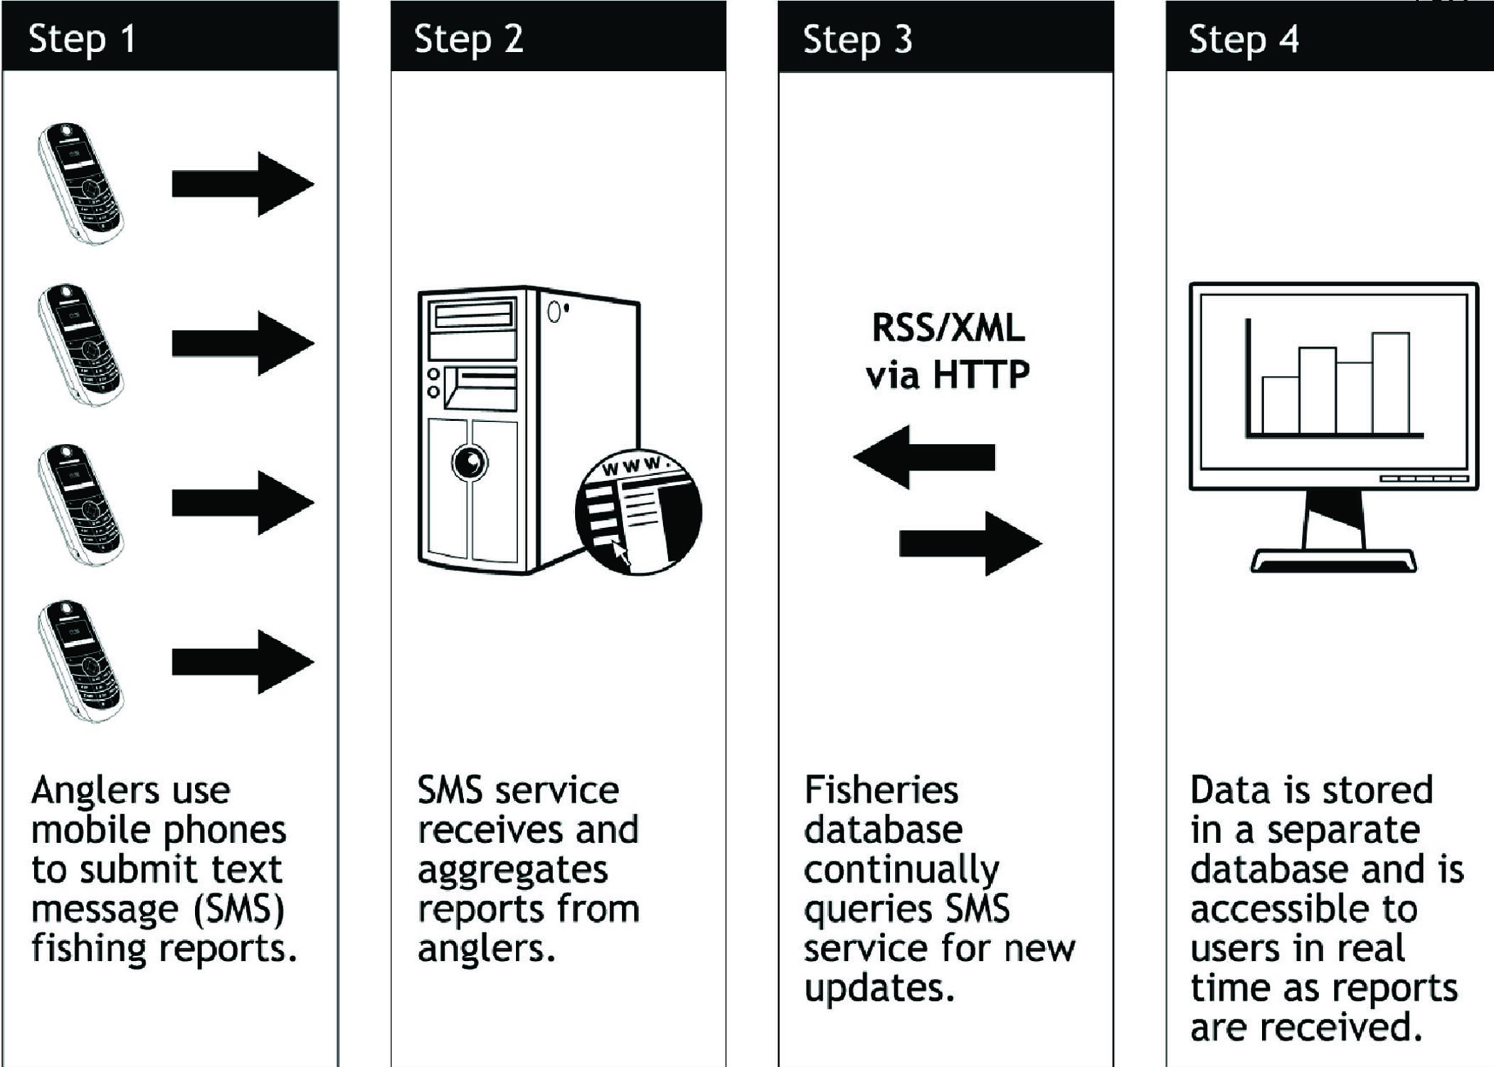
Data Collection Via SMS
Baker and Oeschger, Marine and Coastal Fisheries, 1:143–154, 2009
http://www.tandfonline.com/doi/abs/10.1577/C08-042.1 or www.rectext.org
Notes:
In 2008 a colleague and I developed and tested a text message angler reporting approach that we called RecText. We asked 6 for-hire captains to evaluate the reporting method by texting in their basic trip info at the completion of each trip when they returned to the dock. We asked captains to report simple data using 1 and 2 letter codes and numbers. Fields collected were: # of anglers, hours fished, species, number and disposition. Lengths were optional. In the pilot study we used Twitter as the data aggregator.
The principle findings were that 1) a very low number of errors were observed with this free form data entry but the oldest and least experienced text messagers were prone to more data entry errors, and 2) the approach was useful for a large number of users to contribute a small amount of information in real-time and this could be done with any cell phone on any network. Smartphone use at the time was probably 5-10%.

Slide 3
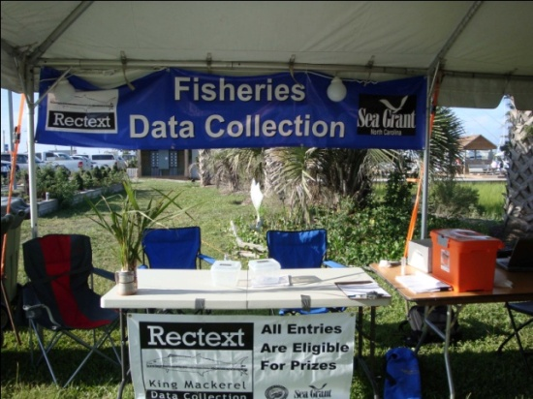
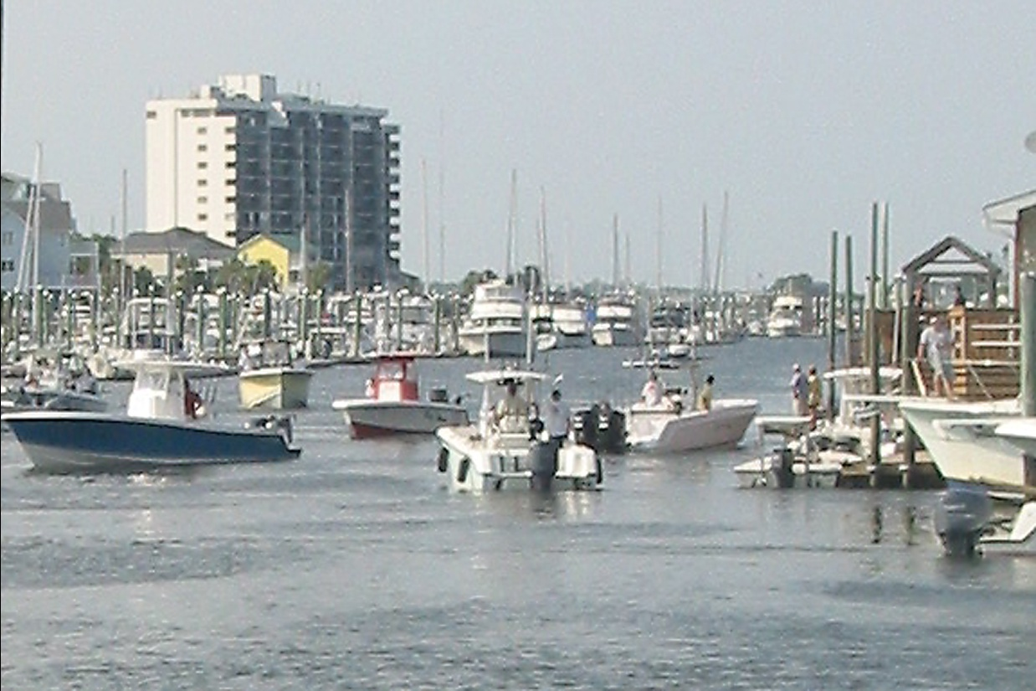
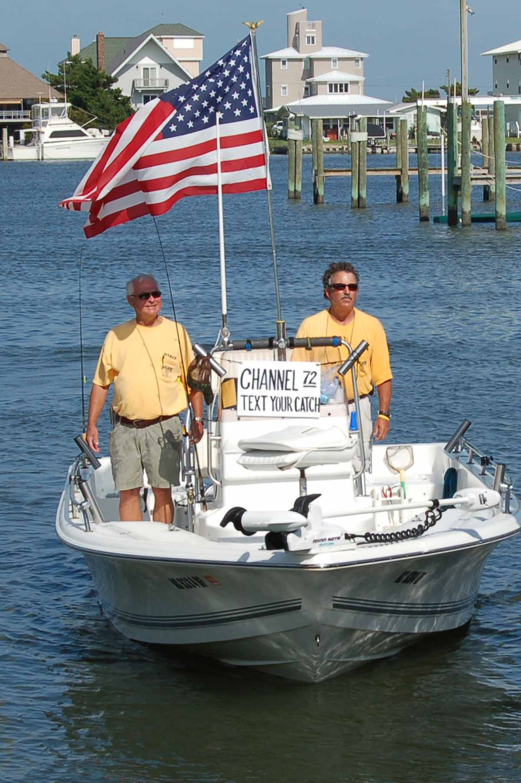
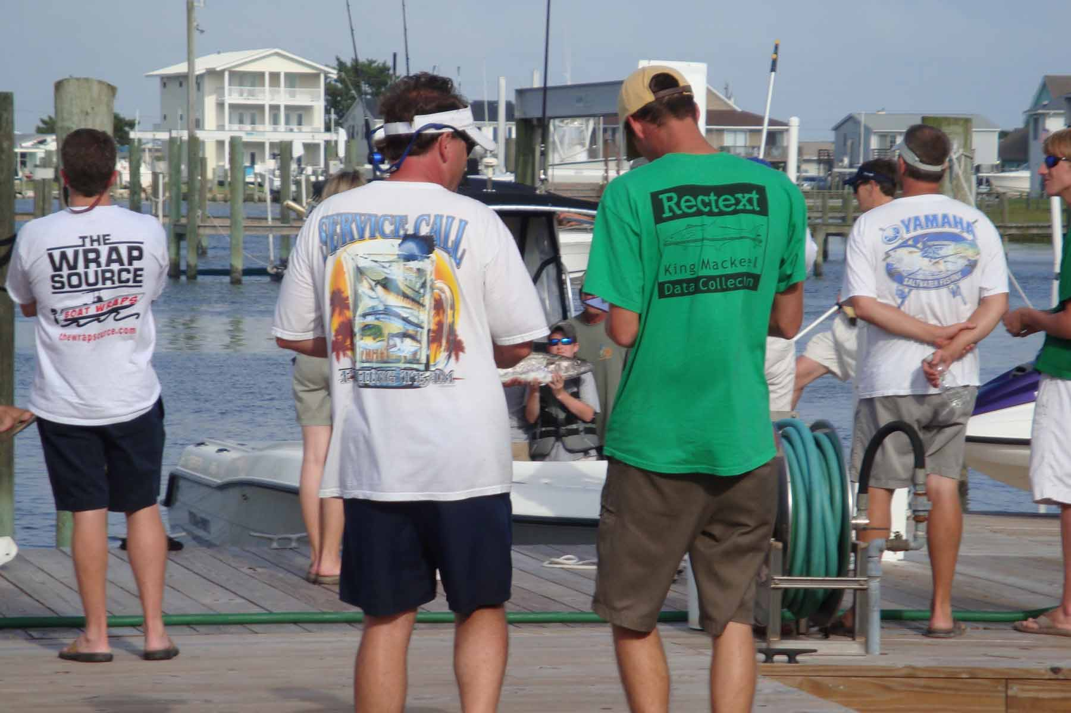
KMT Voluntary Angler Reporting
Notes:
In 2009 and again in 2010, we performed another pilot test of the technology with funding from the state rec fishing license funds – the purpose of which was to use volunteer anglers to provide catch and effort information from specific tournaments in an effort to estimate total harvest of king mackerel from these events. For some species, like KM, tournament harvest is thought to be significant yet events are not part of the standard surveys because of bias associated with tournament fishing behavior. In this study, we attempted to invite as many anglers as possible to participate during the registration period prior to each tournament.

Slide 4
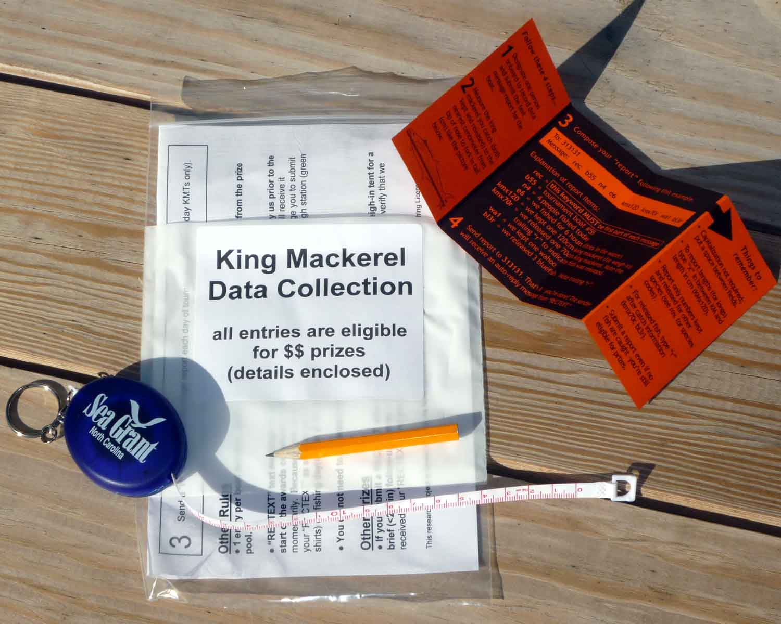
KMT Voluntary Angler Reporting
Notes:
We used one of two methods to introduce anglers to the survey. In the first method, we deploy survey kits to anglers on a face to face basis opportunistically as they completed tournament registration. This method was the most successful. For the second approach, we stuffed a survey kit into each captains bag such that theoretically each captain or team would be aware of the program. Tournament organizers also allowed us to say a few words during the captains meeting to further engage anglers. The sampling kit consisted of a soft tape measure, pencil, welcome letter, and a wallet card with detailed instructions on the text message approach. Everyone who submitted a report, regardless of whether they caught fish, was entered into one or more cash prize drawings held during the tournament awards ceremony.
In 2009, participants were allowed to report by either paper or text, but anglers who submitted text reports were eligible for higher cash prizes. In 2010, only text reports were allowed.

Slide 5
Notes:
We surveyed 6 tournaments altogether. There were 2,224 trips taken by 1,291 boats. Events 1-4 in 2009 and events 5-6 in 2010. The US Open was the only event that were able to sample in both years (4, 6). We observed about a 15% participation rate each year. As you recall I said we removed the paper reporting option in 2010, yet overall we still saw the same level of participation as in 2009 when both methods were offered. This leads us to believe that anglers were able to adopt to the technology and that many anglers recognized the survey program from the previous year. This increase is also supported by the national increase in text message usage by all age groups over the last 5 years. In addition to the participation rate, we needed to know what percent of anglers were successful. Without the survey, we will only have one indication – and that is the tournament record.

Slide 6
Notes:
The dotted line in the middle of the graph indicates the percentage of trips in which king mackerel tournament anglers 1) caught at least one king mackerel and 2) brought it to the scales to be entered into competition. The average weigh-in rate for the tournaments sampled was 39%. For example, in tournament #1, if there were 100 trips taken, only 39 of those trips resulted in a portion of their catch being documented. While this is informative, it doesn’t tell us 1) the additional number of king mackerel that these anglers kept, if any and 2) what percentage of the remaining trips caught fish, and if so, how many. This, of course, was one of the goals of the survey.

Slide 7
Notes:
So we had a fairly consistent participation rate and the weigh-in rate was also somewhat predictable, but we really would like to know if the anglers who submitted surveys were representative of the tournament population at these events. The top line of this graph shows the percentage of trips that completed the survey where the team also weighed in a fish. A common observation among the 2,500 plus anglers that our survey team talked to during the recruitment period was that managers were not interested in trips that accounted for zero catch. As result, at the first 3 tournaments, we principally heard only from a large number of trips that were successful (in other words, definitely caught fish because they weigh-in for competition). However, beginning with event number 4, we utilized the text message platform to send an automated reminder to each team at the end of the day – encouraging them to report – even if no fish were caught. The use of this personal, on the water reminder in the form of a text message had the dual benefit of not only increasing our survey participation rate but also bringing our lowering the bias with respect successful and unsuccessful anglers submitting reports.

Slide 8
Notes:
This was essentially a species-specific survey, and as such, we asked anglers to report on the lengths of king mackerel – both those kept and released. This chart displays total numbers obtained by each 5 CM length bin for released and kept fish as reported by anglers compared to the population of fish that were weighed in to competition. NC DMF obtains measurements and obtains biological samples from about 4 tournaments a year – and we coordinated our survey effort to co-occur with those events. Measurements from one event (US Open 2009) were excluded because only a portion of weighed in fish were measured. We can see that released fish varied considerably in size and included more than just small fish while the size distribution of kept fish (including those that were weighed in) was similar to that measured by officials at the weigh station.

Slide 9
Notes:
In our sample population, 60% of reports were from successful trips or trips that eventually ended in weighing in fish for the tournament and roughly 40% were from unsuccessful trips. Of the 229 completed trip reports, about 25% were indicated that 0 king mackerel were kept. Our survey indicates that trips not weighing in had a lower CPUE than trips that resulted in weighins at each event – but as you can see, on average, even unsuccessful trips resulted in some king mackerel harvest.

Slide 10
Tournament Harvest Estimates
Notes:
Finally, if we calculate total harvest for both successful and unsuccessful trips at each tournament, we can estimate the total king mackerel harvest attributable to each event. In this figrue, the bars on the left are the actual number of KM landed obtained from the tournament record-keepers and the bar on the right indicates our harvest estimate calculated from the survey reponses. While there is quite a bit of variability around the estimates, this approach provides some indication of what tournament harvest might be like.
Furthermore, if we are to compile some basic participation data from the other tournaments, we could technically calculate the total harvest of tournament caught king mackerel and add that to the MRIP survey estimates. Because tournament anglers target large fish, there is the possibility that removal of these large individuals from the population could adversely impact the SSB of king mackerel.

Slide 11
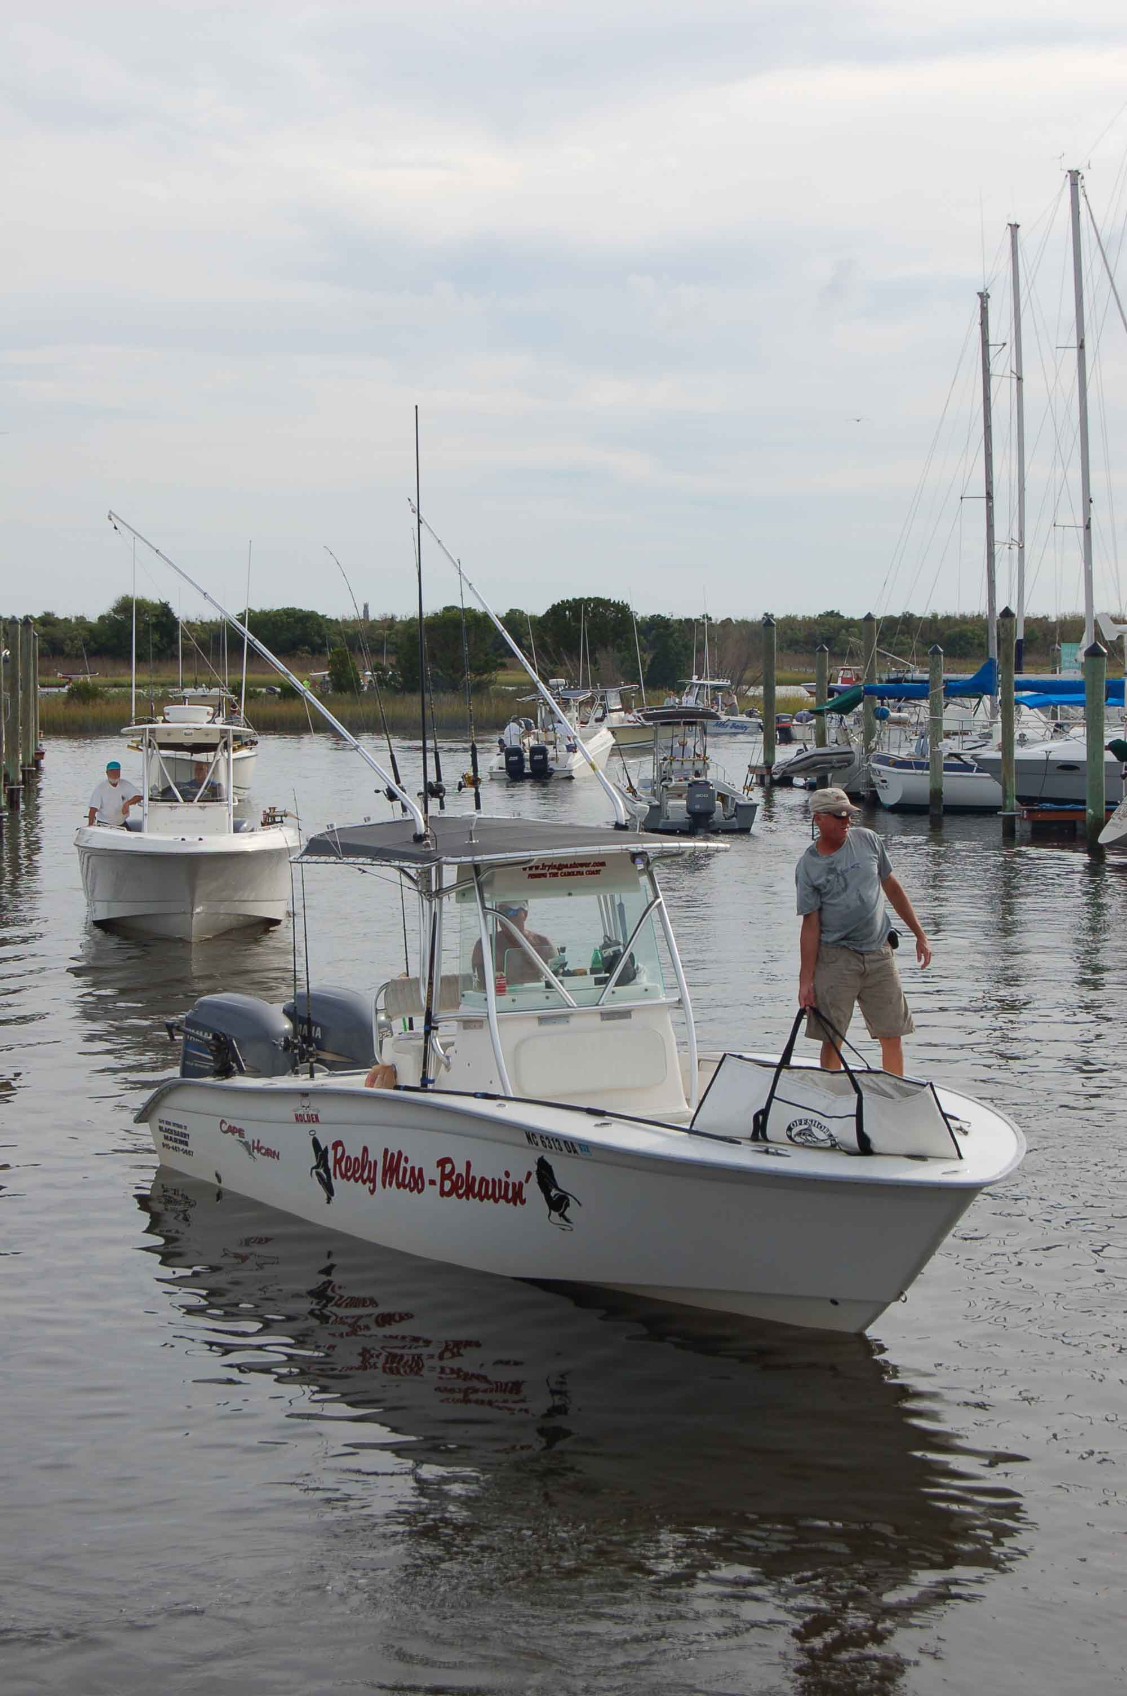
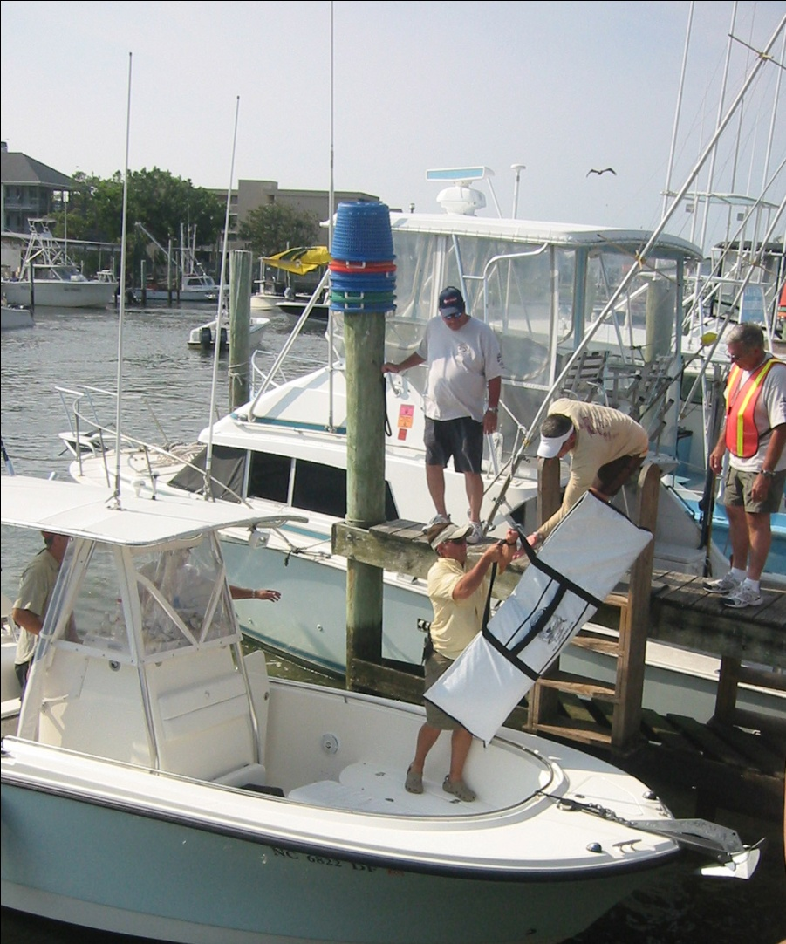
Notes:
I was amazed at the level of data that is routinely collected by these tournaments, particularly the Southern Kingfish Association or SKA Tournaments. If a tournament reporting program were ever to be pursued, in my opinion it would have to actively involve the tournament organizers and the possibly the sponsors. This partnership is important because much of the data requirements used to calculate CPUE can be obtained from the tournament registration database. For example, number of anglers are required on the registration form and effort is bounded by a given day, with start and finish times posted. Because of insurance guidelines, some tournaments are even requiring teams to check-in at the end of the fishing day. Neglecting this rule can be an automatic call to the Coast Guard. Second, many tournaments have prizes donated by sponsors and a data collection category (TWT) could be created as an incentive for anglers to participate. We observed an increase in response rate with the use of a real-time “reminder” message to teams while on the water – but we only cell numbers for a portion of the tournament field. Again, tournament organizers who collect cell phone numbers from registration forms are in a unique position to send updates and reminders to all teams about reporting. Finally, it seems ironic to fisheries biologists but fish lengths are not collected by tournament weigh-masters– only weight. This inclusion would not require much additional effort and would generate an additional index of reported catch.

Slide 12
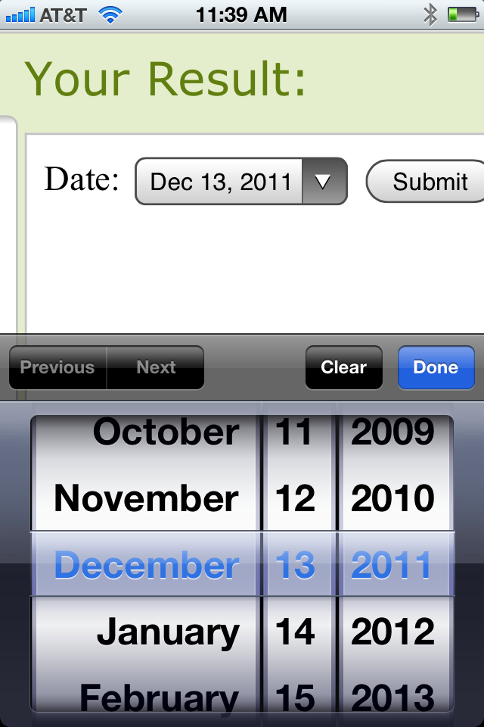
http://www.nielsen.com/content/dam/corporate/us/en/reports-downloads/2011-Reports/state-of-mobile-Q3-2011.pdf
Notes:
And finally, I can say that text messaging was a great way to collect data on the cheap in 2009 and 2010. Despite its limitations, all cell phones are capable of text messaging and this coverage offers a unique opportunity to connect with all potential data collectors. The drawbacks we observed were that the free-form style of data-entry and one-time submission of tournament reporting translated into data entry errors on approximately 50% of the reports (although data was still usable). At this stage, text message report submission for tournament data should probably be limited to frequent text message users or used as a notification tool, such as the reminder.
Moving forward from this study, I would consider the inclusion of smartphones and mobile internet technology as away to engage anglers and report data. We all know that a growing number of Americans are heavily reliant on mobile phones to access Internet-based information, and this undoubtedly includes fishermen. Findings released this year indicate that U.S. smartphone usage more than doubled from 18% in 2009 to 44% in late 2011 as this trend will undoubtedly increase. Many smartphone users use apps but they are significant hurdles for cash-strapped enterprizes. Smartphone Apps would have to be constructed for multiple operating platforms (see the graph above) in order to reach a large number of users. The principle advantage is that once downloaded, interent connectivity is not required to record data – only report it.
For the development of a new electronic reporting system, at this point in time I would recommend using an existing electronic logbook portal (SAFIS, NC recfish, Mass elogbook, etc.) with an add-on “tournament reporting module”. Instead of starting with a dedicated smartphone App, I would recommend creating a mobile version of the data entry screen such that mobile users with internet connectivity (feature phones but most notably smartphones) could perform data entry upon completion of the trip (in other words, at the dock as opposed to at home). This mobile website option would all anglers to report – either on-site or at home, regardless of their smartphone operating system. The benefit to dock-side reporting capability is similar to that of the text message - - on-site validations of report submission and content could be performed if desired, providing an avenue for validation.

