Slide 1
Discussion: Use of ecosystem level productivity as a fishery management tool
New England
Not used in management, but currently under consideration for use in management
Mid-Atlantic
Likely to be under consideration in the near future
South Atlantic
Never considered
Gulf of Mexico
Never considered
Pacific
Never considered
North Pacific
Ecosystem level Caps (OY) on fishery removals for GOA and BSAI.
Western Pacific
Considered for coral reef fish mgt unit, but other approach was taken using traditional information (survey biomass and reliable catch info)
Notes:
Western Pacific: A system level OFL definition was initially proposed for the coral reef fish management unit species but since there were alternative information such as biomass info from transect surveys and a reliable catch data this alternative was dropped.

Slide 2
Further Details
New England
Estimates of ecosystem level production have been produced using various approaches
Estimates are reasonably consistent over time
Not directly used in management (contextual use in groundfish management)
Updated estimates for various regions have been updated using improved methods
The NEFMC is scheduled to vote on whether the production of the system should be used in management
Notes:
The MAFMC has not really addressed the concept of System OYs yet, nor much historically. These systemic OY caps are currently under consideration at various levels for the SSC and the OFL process. Based on what is noted below, the analytical process of estimating aggregate and system level OYs for those regions are underway, but the MAFMC is only in nascent stages of considering these estimates.
The NEFMC, and historically its predecessor ICNAF, has had several estimates of system-level OY and associated caps. The values have ranged variously, for the entire NEUS Shelf LME system or various sub-regions (e.g. Georges Bank, Gulf of Maine), but 1) tend to be consistent in magnitude over time, and 2) tend to be lower than summing SS MSYs/OYs/etc. The historical estimates have not been used directly in mgt, at least until recently. In 2008, we had a GARM III meeting (Groundfish Assessment) where we estimated aggregate group and system-level MSYs. These were used for context for the groundfish assessment and ultimately the groundfish FMP. I or Mike can get you those estimates, values, and more details if you like. More recently, we have updated those estimates for various regions and can similarly provide examples of those if you would like; most germane, we are awaiting a vote by the NEFMC as to whether the production of the system is a management measure they would like to track and use to manage off of. It appears that at some level they would like this information, to what degree is TBD.

Slide 3
North Pacific
2million t OY cap for BSAI Groundfish
Adopted in 1982 based on 85% of MSY range of 1.4-2.0 mill t
Has constrained total catch in some years
Numerous proposals made to increase the upper limit 1984-1990 – rejected due to concerns about biological information, market concerns, impacts on marine mammals and seabirds
Upper limit now codified in legislation – difficult to change
GOA OY Cap
Not constraining
Recent MS production model analysis (Mueter and Megrey 2006) indicate BS OY upper limit is reasonable but GOA limit is too high

Slide 4
Maximum Economic Yield
MEY is usually more conservative than MSY (i.e., B_{MEY} ≥ B_{MSY} ) in conventional bioeconomic models …
Rationale for ACLs as ‘win-win’ strategy (Grafton et al. 2007)
However conventional bioeconomic models treat population as single (dynamic) variable
MEY was extended using explicit population dynamics models for Bristol Bay Red King Crab and Eastern Bering Sea Snow Crab
New fully dynamic and stochastic bioeconomic models that formally treat decision-making under uncertainty (e.g., ex-vessel prices, recruitment)
Estimated using maximum likelihood methods from time series analysis
Could include Bayesian analysis, MCMC, etc. (future work)
Useful for formal probabilistic assessment and other applications
Two-stock BBRKC-EBSSC bioeconomic model is underway to estimate joint MEY
Notes:
Grafton, R., Kompas, T., Hilborn, R. (2007). Economics of Overexploitation Revisited, Science 318: 1601.

Slide 5
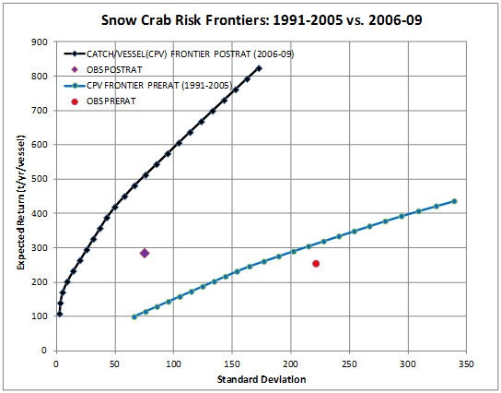
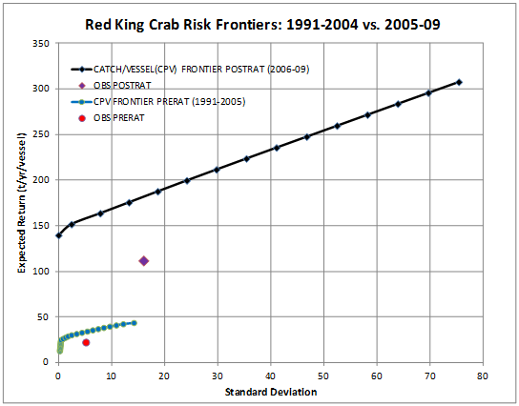
Risk Analysis
Modern portfolio theory and other tools for analyzing financial time series are applicable to fisheries
For example, risk-return frontiers (i.e., Markowitz Bullet) summarize tradeoffs and can be used to assess outcomes …
Can use prices to aggregate across spp. and combine frontiers
ACLs can shift the risk frontier
Notes:
(From Wikipedia): “Modern portfolio theory (MPT) is a theory of investment which attempts to maximize portfolio expected return for a given amount of portfolio risk, or equivalently minimize risk for a given level of expected return, by carefully choosing the proportions of various assets”
Results:
Risk frontiers shifted out post-rationization mainly due to fewer vessels: Greater expected return for given level of risk; lower risk for given expected return
Snow Crab pre/post rationalization : Not much change in expected return but substantial reduction in risk
Red King Crab pre/post rationalization : Substantial increase in both expected return and risk
Closer to the frontier pre-rat than post-rat in both cases – why?
A1) Pre-rat very competitive (2X vessels) w/smaller avg. returns (thus smaller absolute risk);
A2) Post-rat equilibrium still evolving, expect movement towards frontier over time (w/changes in coop composition, fishing strategies, etc.)
Catch Per Vessel (CPV) Risk Frontiers were computed by quadratic programming on catch data (converted to metric tons) for individual vessels from CFEC fish tickets for pre-rationalization and post-rationalization time periods:
- Each crab vessel is treated as an asset, and the expected return for each is its average catch (t/vessel/yr) over the relevant time period
- A portfolio is a vector of weights, one for each vessel. Portfolio risk is defined by this vector of weights and the covariance matrix for catch time series (square root of this term is a standard deviation).
- ”Observed” (OBS) portfolio gives equal weight to each vessel, i.e., average CPV over relevant time period

Slide 6
Most US control rules are of the “threshold” form, i.e.
The ABC is then (roughly) F * B
Multispecies F_{40%} (F_{MSY} proxy)

Slide 7
A multispecies “F_{35%} = F_{MSY}” strategy
Divide the species into “key target” (e.g. Pacific cod; walleye pollock; arrowtooth flounder) and “other species”.
Compute mean recruitment (e.g. age 1) since 1978 from the assessment.
Project the model ahead (with multispecies interactions) given virgin recruitment to estimate “multispecies virgin biomass”.
Set the Fs for the “other species” to averages over recent years.
Solve the Fs for the “key target” species so that:
Notes:
Other relevant paCollie and Gislason (2001)
Age-structured BRPs but not fully multi-species.
Gamble & Link (2009)
Age-aggregated modelling.
Mueter and Megrey (2006)
Age-aggregated modelling.pers:

Slide 8
Pros and Cons of System OY
Pros
Takes ecosystem properties into account
Adds conservatism
If economic considerations are included it meets full definition of OY
Cons
Doesn’t limit harvest of individual groups within the system in an ecologically meaningful way
Quantitative methods used don’t always relate to the way individual stocks are managed (i.e., production models vs. age structured models)
Still in early stages of quantitative system level MEY estimates

