Slide 1
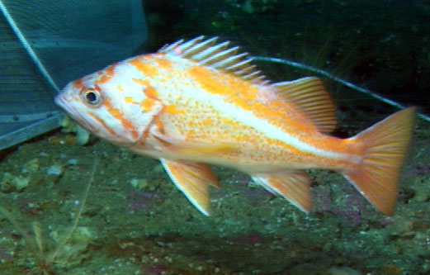
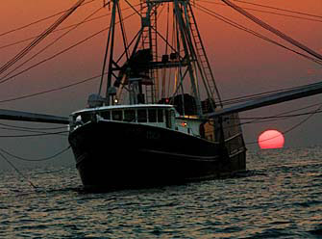
NMFS Overview National SSC Workshop - IV
Richard D. Methot Jr.
Office of Science & Technology

Slide 2
Assessments Completed: Jan 2010 – early Sept 2011

Slide 3
Assessment Model Level

Slide 4
Assessment Review Results

Slide 5
Stock Assessments
“Adequate” assessments for the 230 FSSI stocks are capable of providing stock status information and have passed review.
Are considered to expire from adequacy after 5 years

Slide 6
%Adequate Accomplishment - 2011
Expected number adequate to increase from 134 to 139 in FY11
Got As Expected:
3 to prevent expiration
2 to restore expired
2 new
-3 expiring at 5 years
Unexpected:
-4 attempted assessments did not pass review
-2 retroactive revisions to date or level
-5 delayed until FY12 Q1

Slide 7
Process Improvements
Working on an improved performance measure
Plus up by level, not binary at level 3
Decay by age, not binary at age 5
Requesting more realistic completion dates for when an assessment is finished – basically at SSC acceptance
Advise improved terms of reference for reviews to avoid unrealistic expectations
Advise restricted, targeted benchmarks – don’t re-investigate everything
Include fallback level to avoid complete rejection if most advanced aspects of assessment do not pan out

Slide 8
Prioritization of Assessments
Team Lead: Richard Methot
Facilitating and standardizing regional process for assessment prioritization
Candidate Prioritization Factors
Fishery importance as blend of commercial and recreational, national and regional
Current stock status regarding overfishing/overfished
Stock importance in ecosystem
Assessment frequency – out of date?

Slide 9
Catch/ACL Tracking
Team Lead: Karen E. Greene
Catch/ACL data for all stocks for which there are ACLs will be reported by NMFS HQ beginning in 2012.
Data will be entered in the Species Information System (SIS) database by regional representatives responsible for submitting catch data as soon as they are finalized for a given fishing year.
Reporting on the number of stocks that did and did not exceed their ACLs will be reported to the public on a quarterly basis. It is anticipated that this will be a high profile performance measure since the public is looking for evidence that overfishing has ended on all stocks.
Business rules for developing targets are currently being discussed, as well as ways to communicate to the public the difference between catch relative to the ACL and a determination that overfishing has ended.

Slide 10
Catch Shares
Team Lead: Kelly Denit
In November 2010, the NOAA catch share policy was released, encouraging the consideration of catch share tools to empower fishermen and fishing communities to take greater responsibility for the governance of our fisheries resources with less waste and bureaucracy, and greater effectiveness at ensuring sustainable fish populations, healthy ecosystems and working waterfronts.
NMFS has been working to reduce technical and administrative impediments to designing and implementing catch share programs, providing expertise and related support to assist development of new catch share programs, and developing outreach products to inform stakeholders so they can best participate in the design and implementation of catch share programs.

Slide 11
Optimum Yield
Team Leads - Deb Lambert & Wes Patrick
Archiving OY definitions used in our fishery management plans since 1976, to determine how OY has changed over the years as a result of various amendments to the MSA and National Standard 1 Guidelines.
Two trends in the way OY is defined. Before 1996 the majority of FMPs describe OY as the amount of fish taken under the provisions of the plan, while 1996 to present OY is generally defined as the amount of fish taken under the control rules described in the plan.
The report will briefly describe the history of MSY and OY in U.S. Fisheries, the actions that caused OY definitions to change overtime, and speculate on how OY could be used in the future to promote ecosystem based fisheries management.
Expect Tech Memo by the summer of 2012.

Slide 12
Management Uncertainty
Team Lead - Wes Patrick
Project will describe what management uncertainty is, how it varies among fisheries, and how to adjust for it when setting annual catch targets (ACTs).
Analyzing 22 U.S. fisheries to describe these variances, which target 12 different species that are targeted by a variety of stakeholders, use a variety of management and reporting mechanisms, have differing levels of observer and enforcement coverage, and varying market demand (i.e., $/lb fluctuations).
These fisheries were also chosen because they have 5 to 10 years of landings and target reference points data.
Plan to have a draft manuscript completed by January of 2012.

Slide 13
Other Ongoing Efforts
ABC Control Rule review group
Waiting for all FMP amendments to be completed
NS2 Guidelines
Resumed efforts, nearly ready
ACL Science Workshop Report

Slide 14
FY12 Budget Priorities
$15M increase to the Expand Annual Stock Assessment budget line
More fishery independent surveys to provide abundance data for more stocks, including recreationally important stocks
More use of advanced sampling technology to improve the surveys
Update assessments for more stocks more frequently
Notes:
$67.1M total

