Slide 1
Council Habitat Update
June Council Meeting
June 17, 2020

Slide 2
Today
Update on the Northeast Regional Habitat Assessment (NRHA)
Overview of Habitat Climate Vulnerability Assessment (HCVA)results
Habitat Conservation Division review of regional projects of interest
Developments at the Responsible Offshore Science Alliance (ROSA)

Slide 3
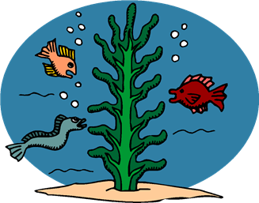
Projects Support Future Council Work
NRHA and HCVA work will feed into number of Council products
Essential Fish Habitat (EFH) Redo - resulting in improved EFH descriptions potentially considering climate, vulnerability
Improved habitat information for State of Ecosystem Report, EAFM Risk Assessment, etc.

Slide 4
Why are we getting a Habitat Conservation Division Update?

Slide 5
Today
Update on the Northeast Regional Habitat Assessment (NRHA)
Overview of Habitat Climate Vulnerability Assessment (HCVA)results
Habitat Conservation Division review of regional projects of interest
Developments at the Regional Offshore Science Alliance (ROSA)

Slide 6
Northeast Regional Habitat Assessment (NRHA)
To describe and characterize estuarine, coastal, and offshore fish habitat distribution, abundance, and quality in the Northeast using a partnership driven approach.
Notes:
Improving habitat science through a partnership and steering committee comprised of 2 Councils , Commission (States), Fish Habitat Partnerships, NOAA NMFS and NOS, Universities and an ENGO.

Slide 7
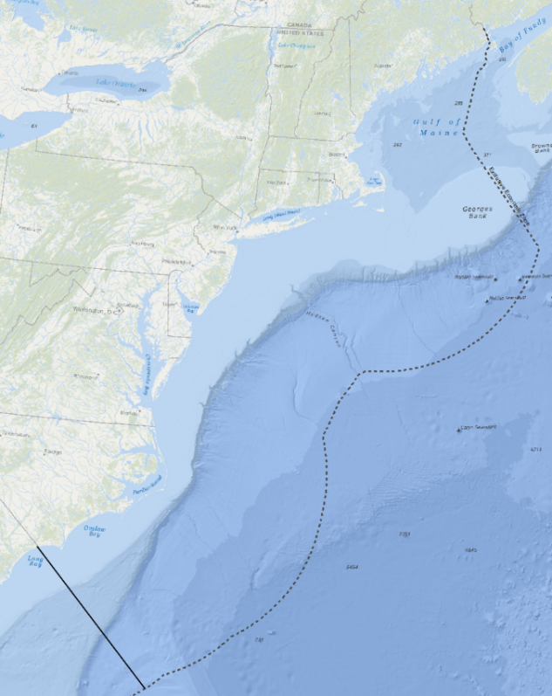
Geographic Scope: Northeast U.S.
North Carolina/South Carolina boundary to the western end of the Scotian Shelf
Includes the Mid-Atlantic Bight, Southern New England, Georges Bank, and the Gulf of Maine
Inshore team focus from NOAA mean high tide/high marsh, to offshore extent of state surveys/state waters; offshore team focus is coastal marine waters to the edge of the continental shelf
Different products from inshore/offshore teams that will be integrated

Slide 8
Focus Species (65+, important to managers)
Mid-Atlantic Council: Atlantic and chub mackerel, butterfish, longfin and shortfin squid, surfclam, ocean quahog, summer flounder, scup, black sea bass, bluefish, golden and blueline tilefish, spiny dogfish
New England Council: Cod, cusk, haddock, pollock, Acadian redfish, plaice, halibut, winter flounder, witch flounder, yellowtail flounder, wolffish, windowpane, ocean pout, offshore, red, and white hake, monkfish, Atlantic herring, salmon, skates (seven species), red crab, sea scallop
Additional Atlantic States Marine Fisheries Commission (ASMFC): Eel, lobster, croaker, menhaden, striped bass, Atlantic sturgeon, black drum, cobia, horseshoe crab, Jonah crab, northern shrimp, red drum, shad and river herring, Spanish mackerel, spot, spotted seatrout, tautog, weakfish, coastal sharks
Highly migratory with Habitat Areas of Particular Concern (HAPC) designations: Sandbar shark, dusky shark

Slide 9
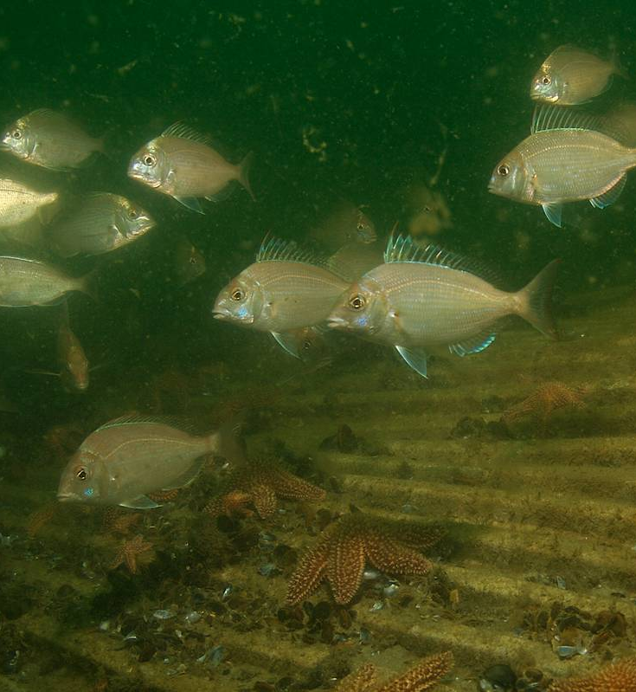
4 Actions Being Considered
Abundance and trends in habitat types in the inshore area
Spatial descriptions of species habitat use in the offshore area
Habitat vulnerability
Habitat data visualization and decision support

Slide 10
Project teams
Project Coordinator: Jessica Coakley
Team leads: Jessica Coakley & Michelle Bachman (inshore); Laurel Smith (offshore)
Technical leads on GIS and modeling work: Chris Haak, Tori Kentner
Inshore team members: Bryan DeAngelis, Julie Devers, Stephen Faulkner, Zack Greenberg, AK Leight, Dave Packer, Mark Rousseau, Eric Schneider, Alison Verkade, Zack Greenberg
Offshore team members: Rich Bell, Kevin Friedland, Vince Guida, Donna Johnson, Kathy Mills, Ryan Morse, Marta Ribera, Vince Saba, David Stevenson, Marek Topolski, Harvey Walsh, Ryan Morse, Rob Latour
Habitat Climate Vulnerability Assessment: Jon Hare, Mike Johnson, Mark Nelson, Emily Farr, others

Slide 11
Joint inshore/offshore products
Spatial data inventory
Location and extent of habitat types plus other useful data sources (covariates, etc.)
Species distribution data from state and federal fisheries-independent surveys
Written inventory of life history and habitat use for each focus species (focus species profiles)
Habitat data visualization and decision support tool
Will begin this work in later stage of assessment
Maintain, house, and refresh products that are developed
Updates every 5 years

Slide 12
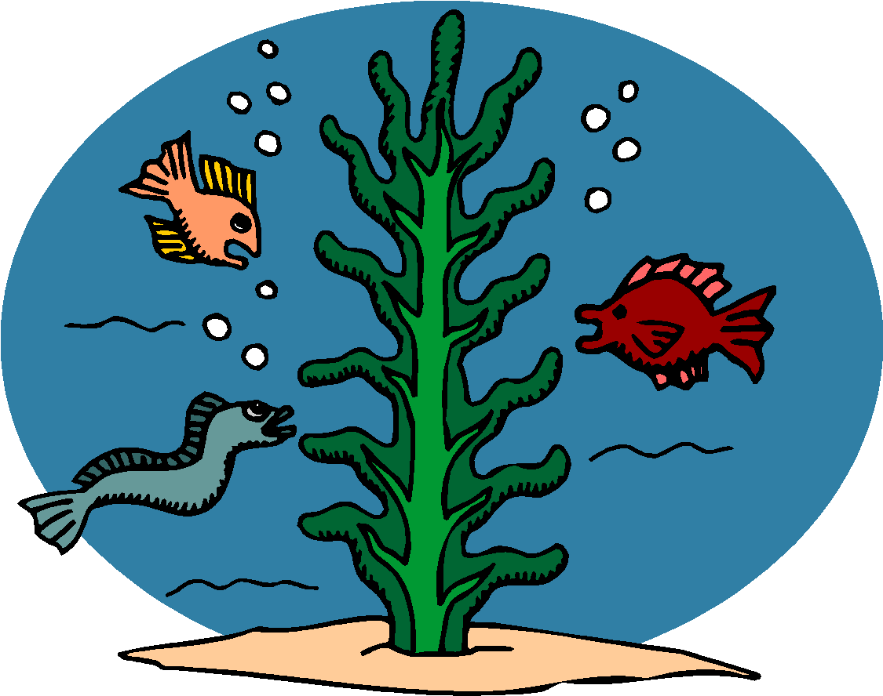
What types of data are we including in the spatial data inventory?
Sediment and Benthic
Bathymetry
Temperature
Coastal Habitat Types (i.e., submerged aquatic vegetation, oyster reef, tidal marsh, hard bottom)
Productivity Data (i.e., chlorophyll, zooplankton, etc.)
Hydrodynamic Data
Climate Model Outputs
Focus Species Distribution and Abundance
Notes:
Figure out what’s available, and then make some choices about data quality and what will be used.

Slide 13
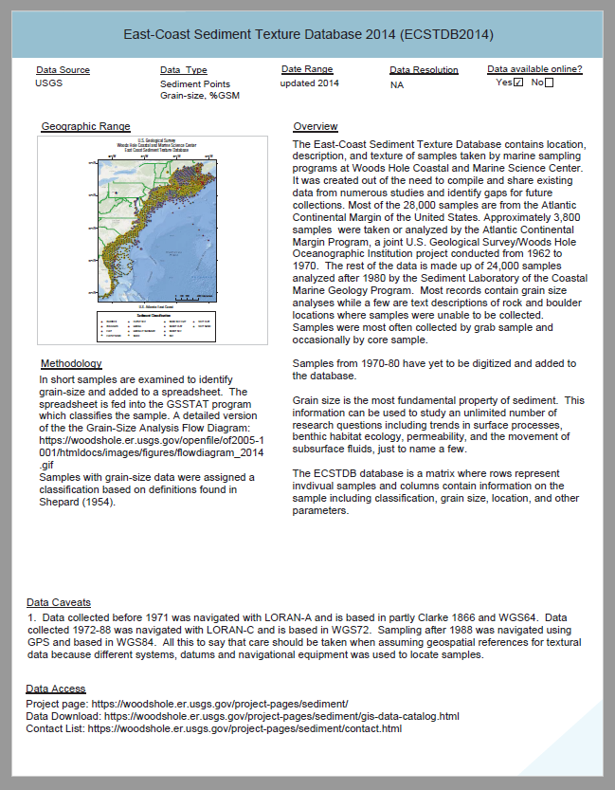
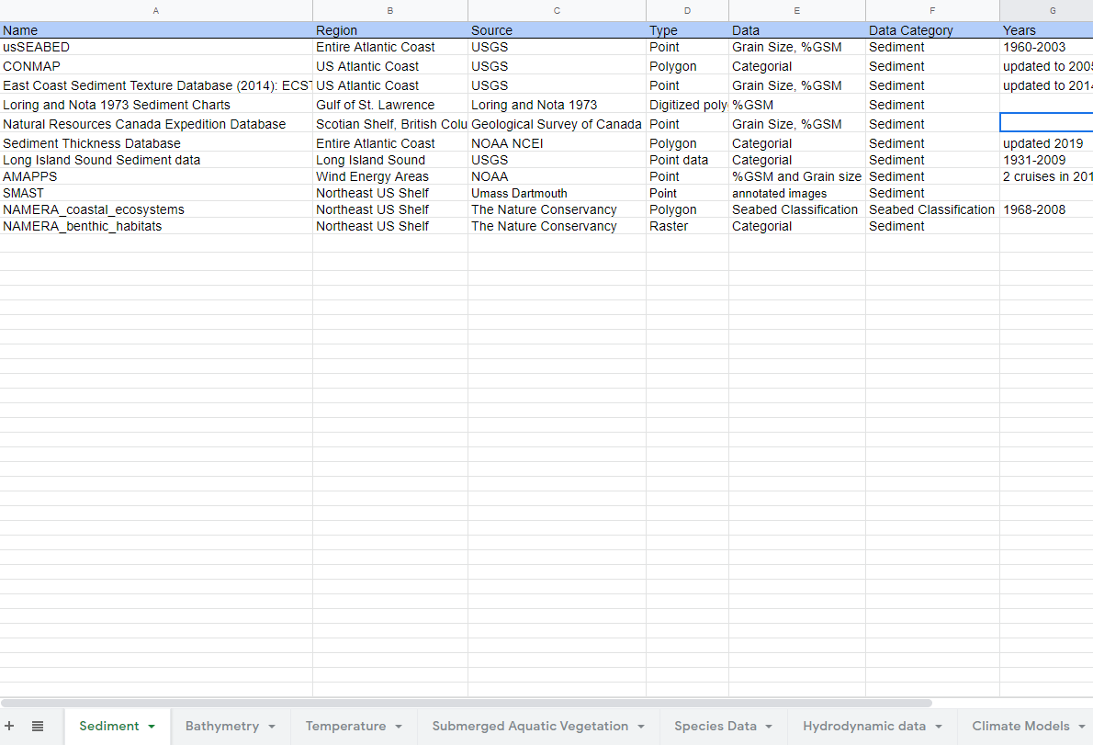
Data inventory compiled as both a spreadsheet and a detailed written report

Slide 14
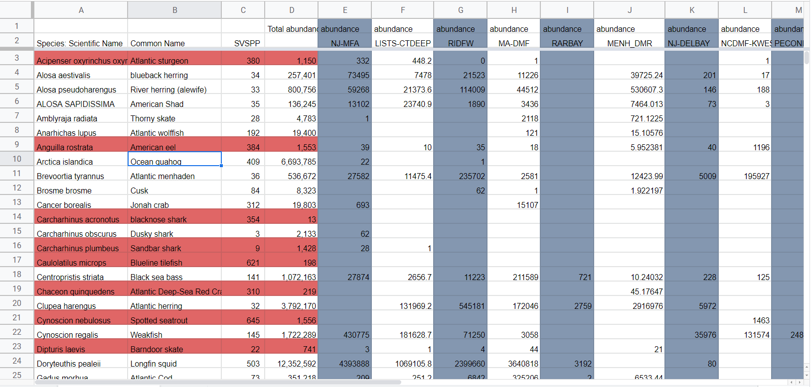
NOAA Fisheries, DFO, and State trawl data compiled by species
Listing species by trawl reveals which species are data rich and which are lacking in data.
It also indicates the quantity of a species collected by each trawl.

Slide 15
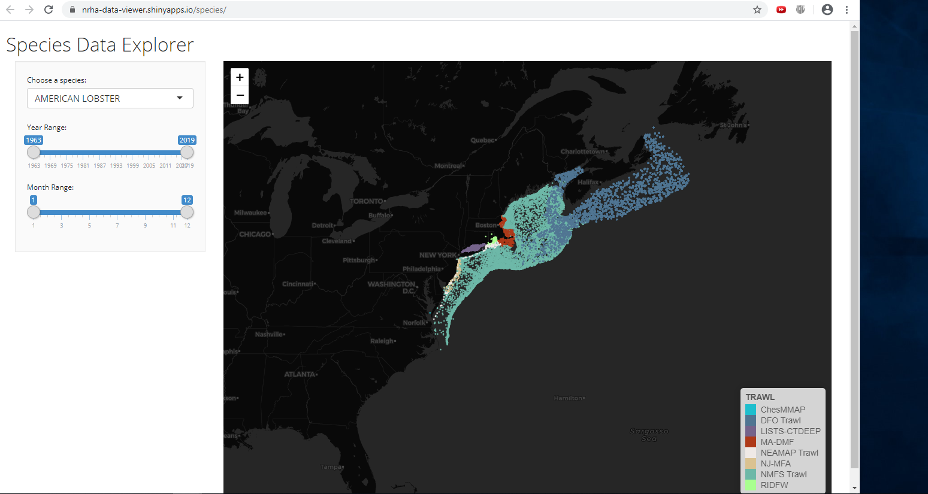
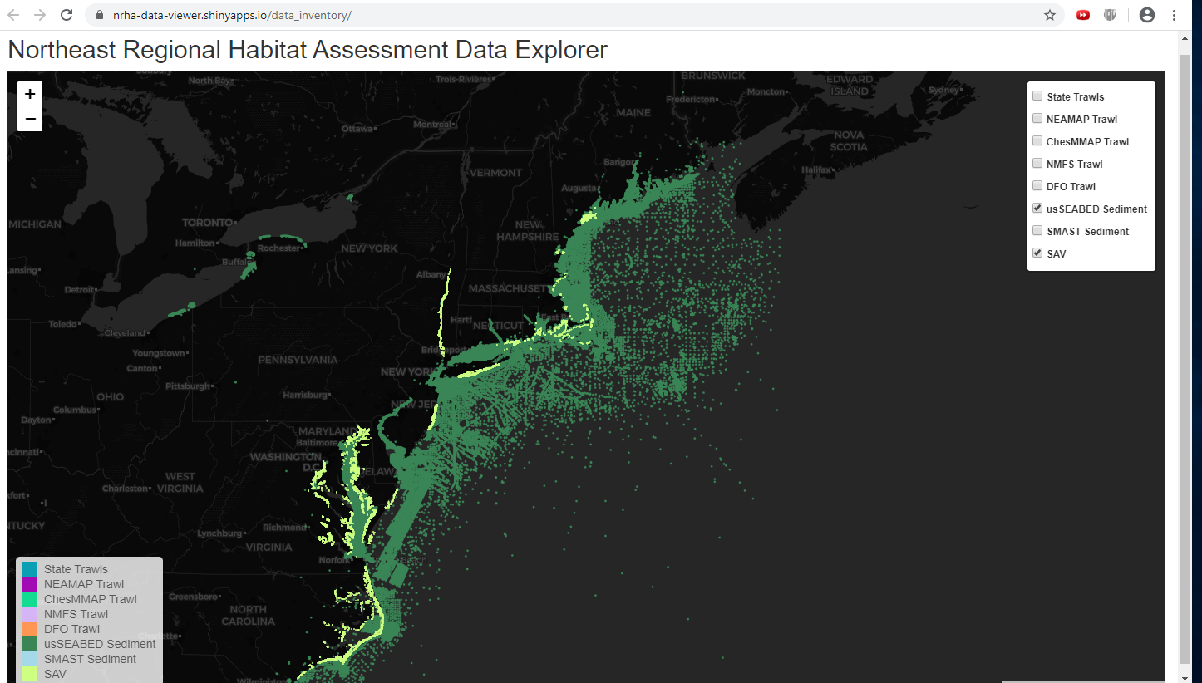
Two R Shiny Apps built for data visualization, exploration and sharing among teams
https://nrha-data-viewer.shinyapps.io/data_inventory/
https://nrha-data-viewer.shinyapps.io/data_inventory/

Slide 16
Characterizing habitat use and species distributions: Modeling framework
Complementary approaches:
“Traditional” (single-species) distribution models (SDMs)
Preliminary research in 2018/19 was conducted on GAM, Random Forest and MaxEnt models.
“Joint” species distribution models (JSDMs)
Model several spp. collectively as a group (inshore/offshore, benthic/pelagic sp.)
Initial testing phase
Notes:
Figure out what’s available, and then make some choices about data quality and what will be used.

Slide 17
Species distribution models (SDMs)
Describe a species “habitat niche” as a function of biotic and abiotic predictor variables
“Environmental filtering”
Physiological tolerances (temp, salinity)
Ecological requirements (SAV, structure)
Don’t explicitly deal with spatial and temporal dependency
Observations closer to each other in space and time may be related

Slide 18
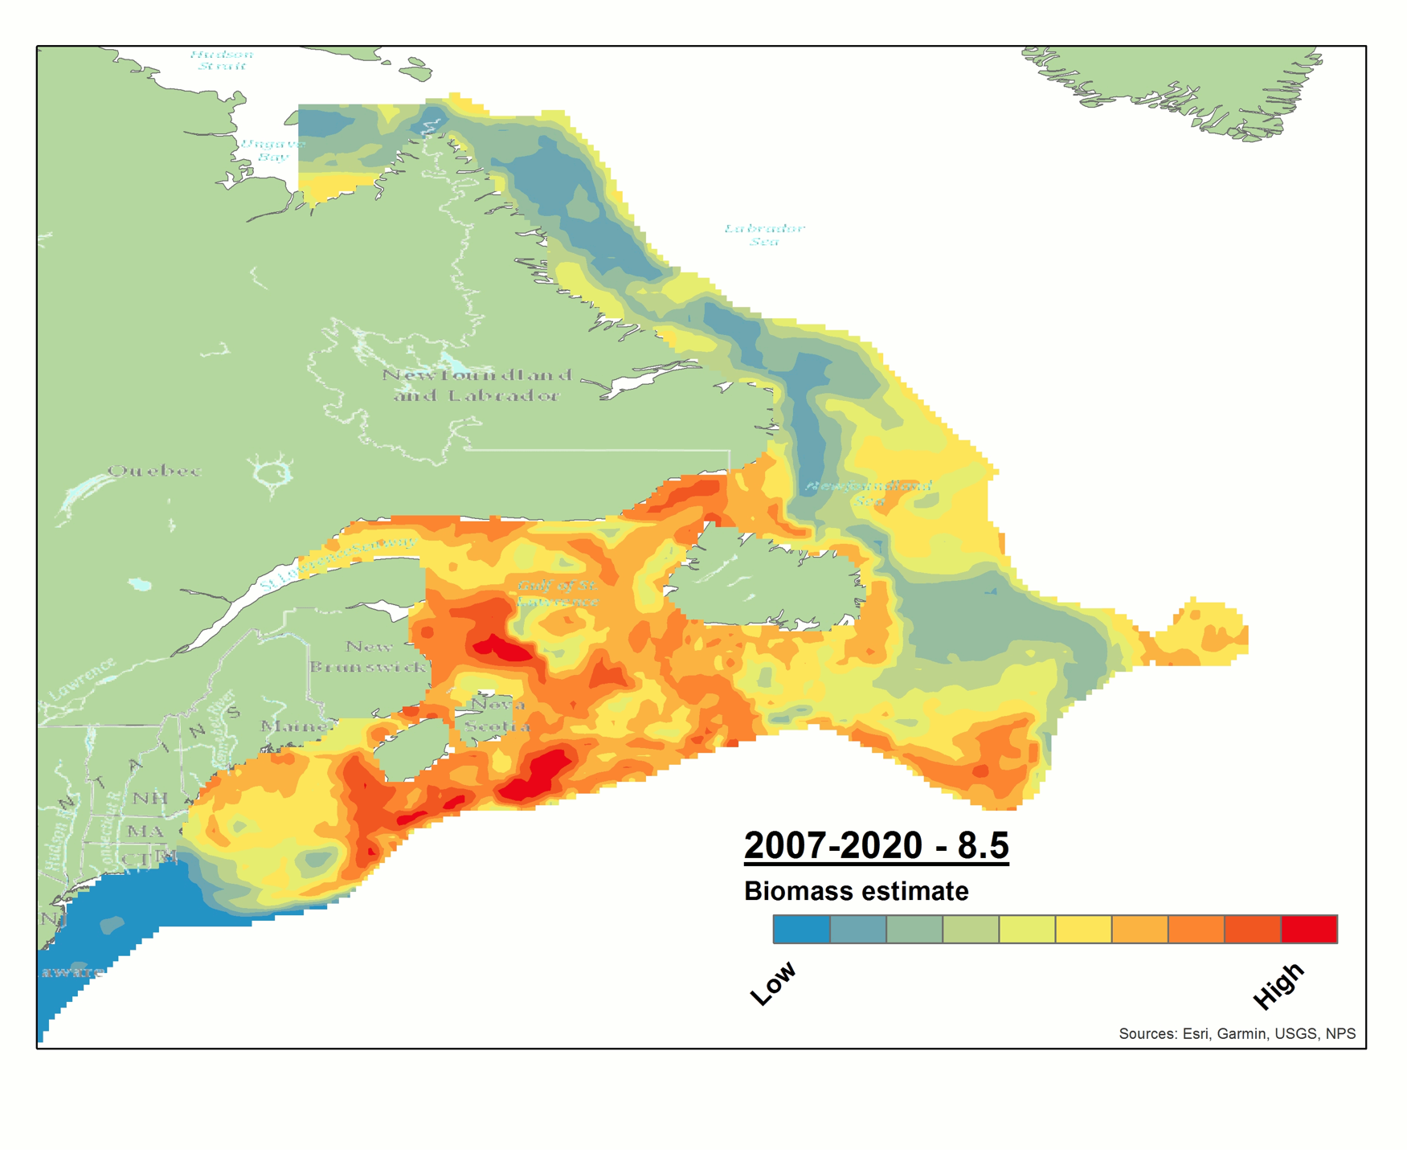
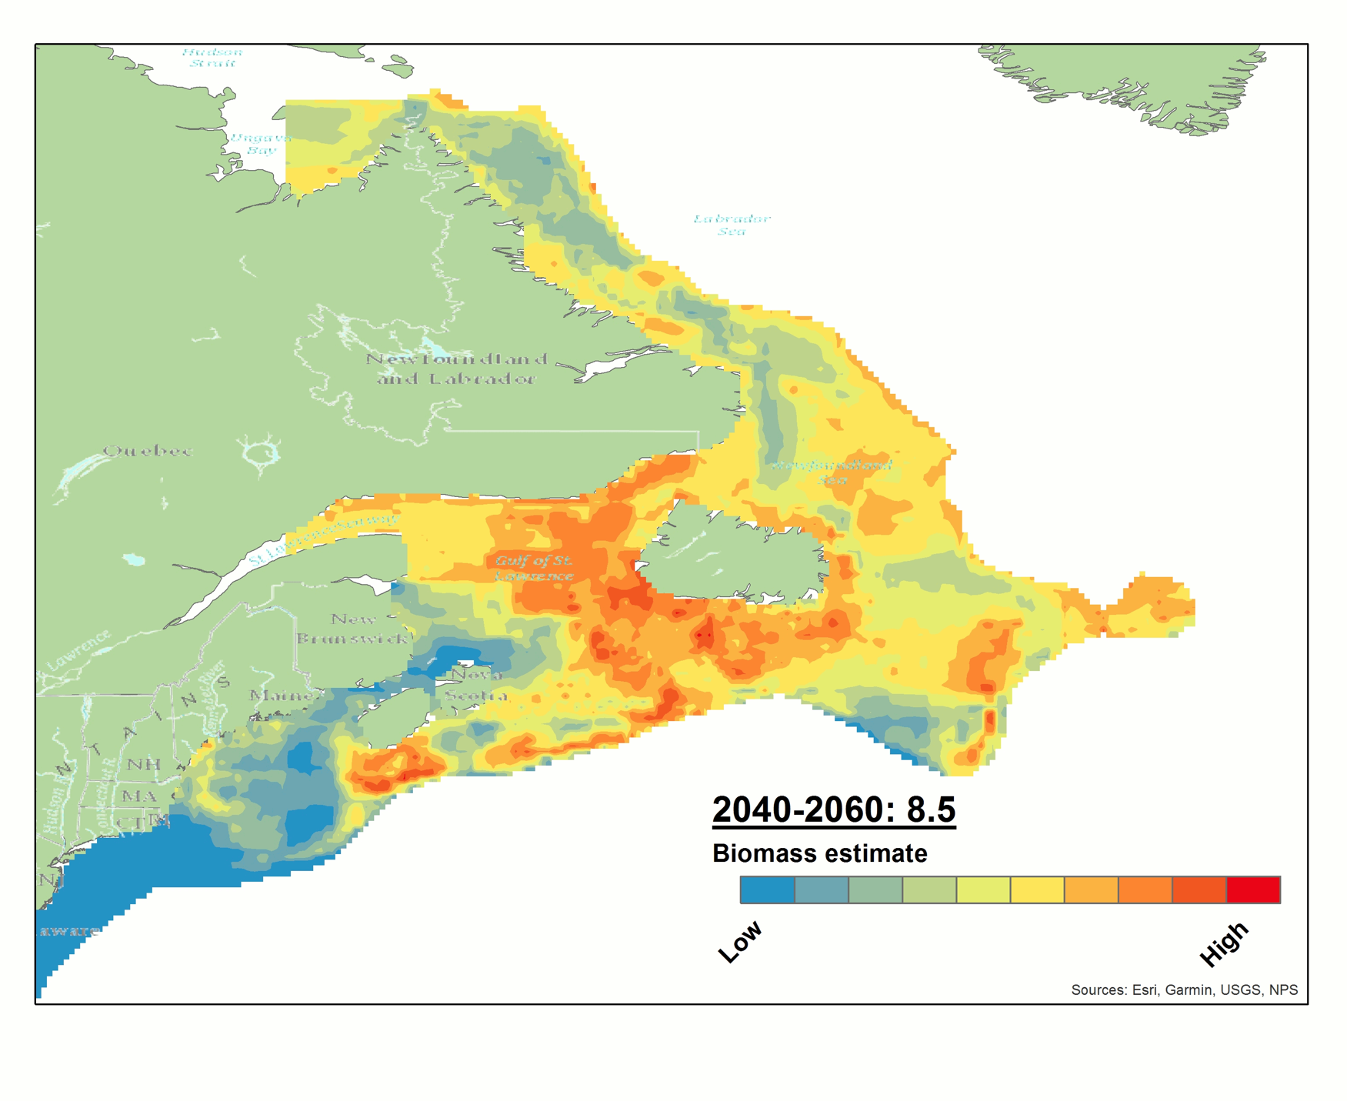
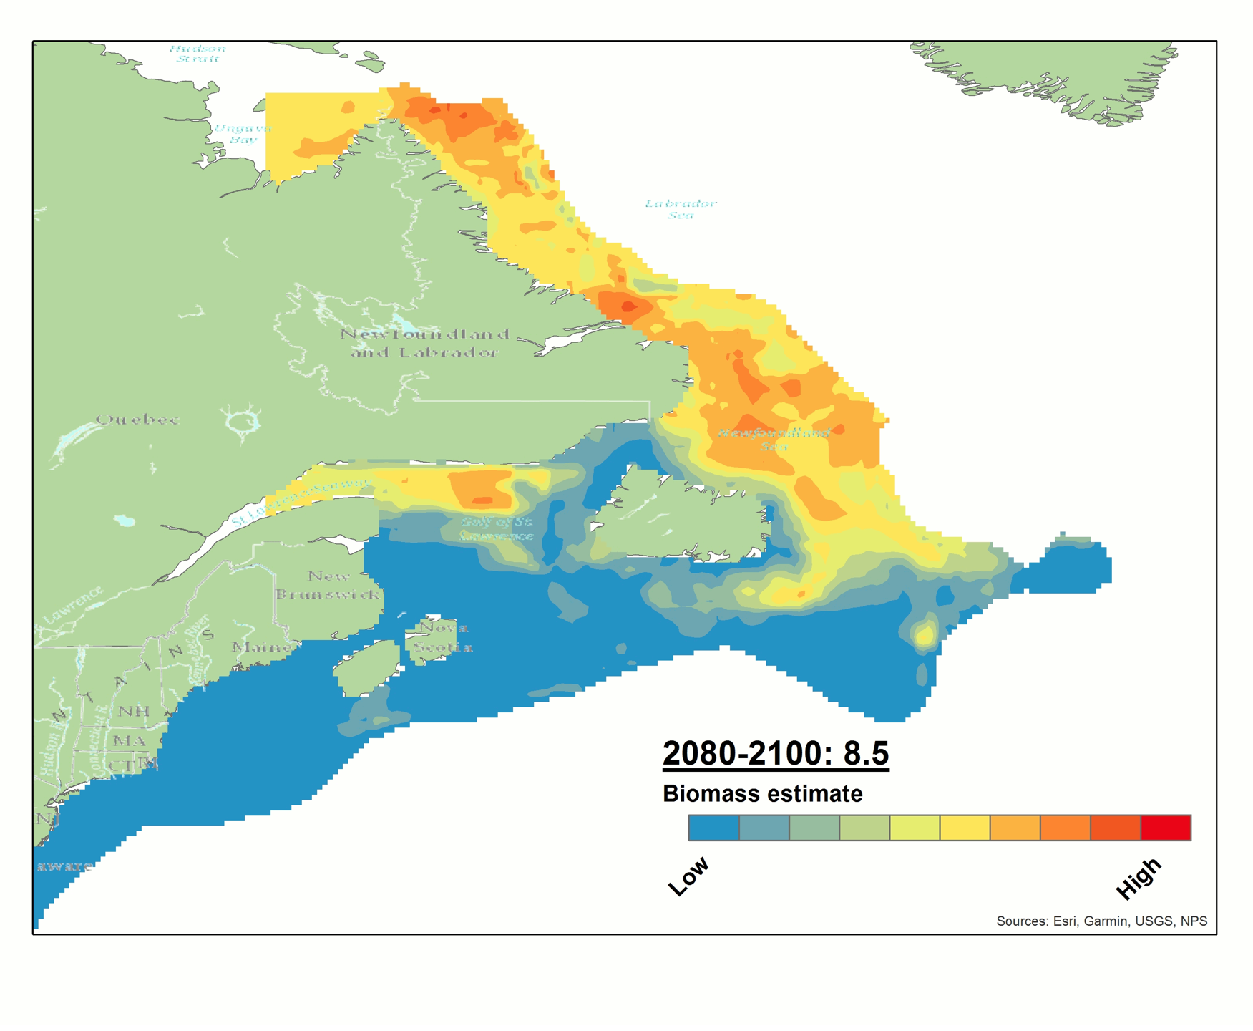
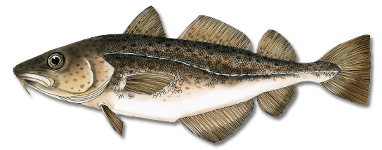
Species distribution models (SDMs)
Estimated niche can be used to predict how distributions may respond to future environmental change (e.g., atlantic cod)
Present
2040-2060 (RCP 8.5)
2080-2100 (RCP 8.5)
Notes:
cod ranges from Greenland to Cape Hatteras, NC, most common on Georges Bank and in the Western Gulf of Maine
Benthospelagic fish living near the bottom
Cod spawn on the ocean floor from winter to early spring
As adults Apex predator in bottom ocean communities feeding on a variety of invertebrates
It is a heavy bodied ground fish species. It depth ranges is from surface to >450m.
And they are found within temperatures ranging from 0-13° C.
Both the Gulf of Maine stock and the Georges Bank stock have been determined as overfished, fishing is allowed at reduced levels.

Slide 19
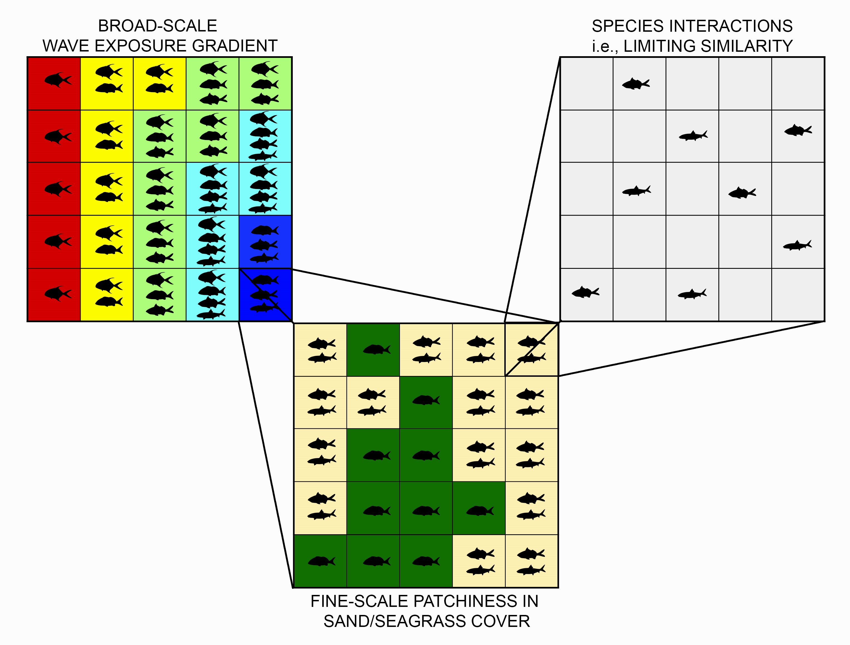
Distributions and community assemblage
Species distributions reflect the outcome of multiple processes:
Environmental filtering
Species interactions
Competitive exclusion, predator-prey, facilitation
(NOT assessed in traditional SDMs)
Interactions may be evidenced by (+) or (-) associations in space and/or time
i.e., spatiotemporal overlaps (or lack thereof)

Slide 20
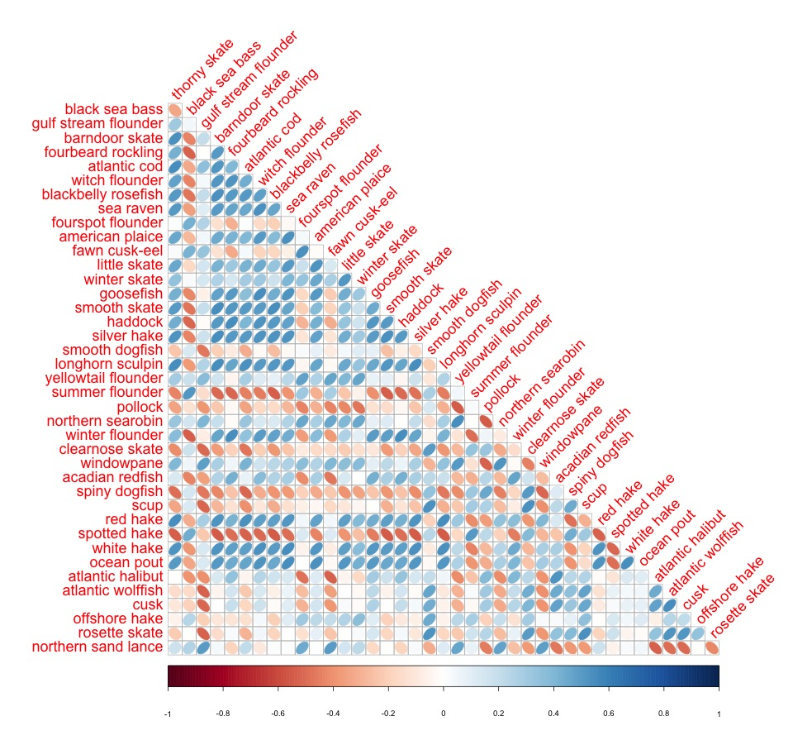
Joint-species distribution models (JSDMs)
Simultaneous estimates of:
Species-environment relationships (environmental filtering)
Species covariation with each other (evidence of interactions?)
JSDMs exploit patterns of between-species covariation to improve predictions
Particularly for rare taxa or those weakly related to environmental factors

Slide 21
Joint-species distribution models (JSDMs)
Generate predictions at the community-level
Based not only on environmental variables, but also on surrounding species composition
Spatiotemporally structured
Disentangle drivers of species association
Are spatiotemporal overlaps (or lack thereof) explained by shared environmental response, or by putative interactions?

Slide 22
Ontogeny and stage-based modeling
Ecological requirements vary with developmental stage
Habitat shifts
(i.e., coastal estuaries > offshore)
Diet shifts
(i.e., invertivore > piscivore)
Pooling distinct life stages can “dilute” niche signal
Less accurate predictions
Overlook important shifts?
Yellow = Red Hake < 20 cm
Red = Red Hake > 20 cm

Slide 23
Ontogeny and stage-based modeling
Strong competition b/w adults
Species interactions are also heavily stage (or size) dependent
Habitat/diet shifts affect the strength and types of interaction between individuals
(i.e., competition > predator-prey)
Partitioning species into distinct stages (or size classes)
Helps to resolve habitat shifts
Accommodates changes in the type/strength of inferred interactions
Sp. B
Sp. A
No interaction
Preys on juveniles
Sp. B
Weak competition b/w juveniles
Sp. A

Slide 24
End Goals & Products
Compare single-species SDMs and JSDMs
Identify key environmental drivers (at species and community level)
Infer potentially important associations/interactions (“Indicator” species?)
Inform EFH designation
Predict future distribution shifts

Slide 25
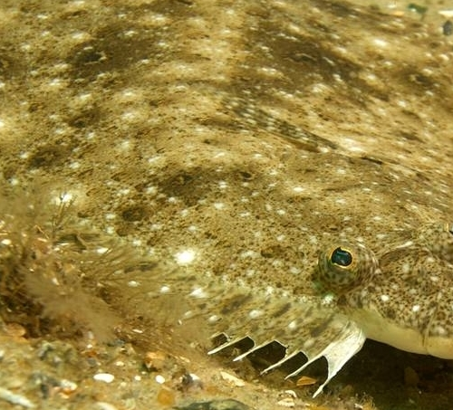
Next Steps
Finalize data inventory and data set assembly; metadata reports
Build out the single-species and joint models with the new datasets
Continue to explore reporting and decision support formats/approaches
Update Steering Committee in late August/September 2020

Slide 26
Today
Update on the Northeast Regional Habitat Assessment (NRHA)
Overview of Habitat Climate Vulnerability Assessment (HCVA)results
Habitat Conservation Division review of regional projects of interest
Developments at the Responsible Offshore Science Alliance (ROSA)

Slide 27
Today
Update on the Northeast Regional Habitat Assessment (NRHA)
Overview of Habitat Climate Vulnerability Assessment (HCVA)results
Habitat Conservation Division review of regional projects of interest
Developments at the Responsible Offshore Science Alliance (ROSA)

Slide 28
Today
Update on the Northeast Regional Habitat Assessment (NRHA)
Overview of Habitat Climate Vulnerability Assessment (HCVA)results
Habitat Conservation Division review of regional projects of interest
Developments at the Responsible Offshore Science Alliance (ROSA)

