Slide 1
Preparing East Coast Fishing Communities
for an Era of Climate Change
Scenario Planning Toolkit
July 2023

Slide 2
Scenario Planning Toolkit: Background
Scenario planning is a tool used by organizations to prepare for a future of uncertainty.
From 2021-2023, several East Coast fishery management organizations collaborated in a scenario planning process involving several hundred stakeholders. The objective was to explore how fisheries and governance would have to change to prepare for an era of climate change. The results of that exercise are highlighted on the East Coast Climate Change Scenario Planning webpage, and are described in more detail in the East Coast Climate Change Scenario Planning Summit Report and Potential Action Menu linked on that page.
The process was valuable for fishery managers – and it can be replicated by and for other other stakeholder groups who want to explore how climate change (and other factors) might affect their future. It doesn’t need to take 2 years! You can hold a helpful scenario conversation in a 1 or 2 day session, or even a meeting lasting a couple of hours.
This toolkit is designed to be used by any East Coast fishery stakeholder. It briefly summarizes the ECSP scenario work and offers suggestions for how other groups can use the material to have valuable conversations about the challenges of climate change.

Slide 3
Scenario Planning Toolkit: Table of Contents
The following sections of slides can be used depending on the goal of the scenario conversation, and the time available
Slides 4-7: Definition of scenarios and explanation of why it can be a valuable process
Slide 8: Identifying the specific reason why to use scenarios
Slides 9-19: Exploring trends and drivers of change to create a scenario framework
Slides 20-26: Describing the ECSP scenario framework and main elements of each story
Slides 27-36: How to use scenarios to generate ideas to prepare for the future
Slide 37: Wrap up slide
Slide 38: Links to additional toolkit resources for conducting a scenario planning effort

Slide 4
The reason why we need scenarios: we’re not good at thinking about the future
Notes:
Any planning work we do requires us to make an assessment of the future.
We look ahead everyday at things like the weather or market trends like the cost of gas. We put a lot of faith in these forecasts and predictions and make decisions based on what others tell us is going to happen, or what we think will happen. The trouble is, history, and our own experiences, tells us that we’re not particularly good at thinking about the future.
A lot of this is based on our assumptions. We tend to believe that we can see clearly what’s ahead of us, and where we are faced with clear choices and clear consequences. Whether we do this or do that. We know what direction we need to go or at least we think we do.
But in reality the future is much more confusing, indistinct and blurry. We can’t see clearly what’s in front of us and we are often surprised by something we didn’t expect.
The result is that often people don’t think sensibly about the future. We are overconfident in our predictions, and we think narrowly about what might happen. We don’t often account for the fact that surprises can occur, creating a world that seems quite different from the one that we had assumed would play out.

Slide 5
What is scenario planning? A way of asking better questions about the future
What will happen?
What should happen?
What might happen?
“Scenario planning uses provocative stories about the future to help change the minds and actions of a group of people”
“Scenarios are stories about the ways that the world might turn out tomorrow…”
Notes:
Another way to think about this is - that when we plan and assess the future, we often default to a couple of questions.
The first and most common, is: what will happen? This is really what we hope to know. It’s why we invest so much in predictions, projections, and forecasts. But we have no guarantee that we’ll be accurate, and the track record of predictions is usually not good.
The second question is: what should happen, or what would we like to have happen? This question is the basis for many visioning exercises. The trouble is, we don’t have full control over the future, so this question can only take us so far.
The most effective question to ask is this third one: what might happen? This encourages us to imagine different possibilities, which puts us in a much better position to consider an uncertain future.
Scenarios are stories about the ways that the world might turn out tomorrow, and scenario planning is then figuring out what to do in preparation.
Scenario planning uses uses provocative stories about the future to help change the minds and actions of a group of people

Slide 6
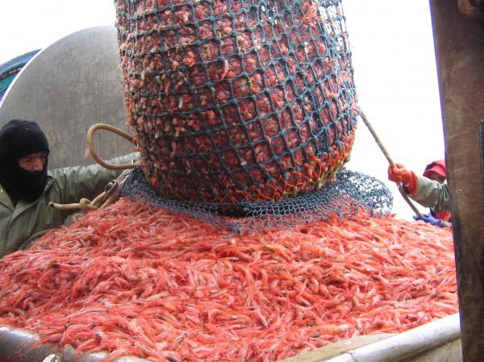
Benefits of scenarios
1
Quicker reactions to a changing world
2
Early and broad risk identification
3
Innovative ideas
More considered decisions and flexible plans
4
5
Trust-building and alignment towards a preferred future
Notes:
Scenarios are provocative stories about what might happen in the future. They are valuable because they help organizations be better prepared for the future. They can do this in a number of ways:
Deliver quicker reactions to changes that have occurred – because we’ve thought about them in advance, we are less shocked when surprises happen
Early risk identification – organizations have their heads up imagining the challenges of the future, not heads down
New ideas that result from broader thinking
More considered decisions and flexible plans – plans that take account of a range of different possibilities
Bring people together – and build trust - so that they can work collaboratively towards shaping a better future
Overall, the main benefit is to ensure that people, groups or organizations do not plan on the basis of a single view of the future. The future is more complicated than that, and scenarios allows us to acknowledge it.

Slide 7
Steps in a Scenario Process
1
7
Identify Issues to Address
Communicate & Continue
2
Look Ahead: Driving Forces
6
Generate & Prioritize Options
3
5
Building Blocks
Build Out Scenarios/
Identify Implications
4
Scenario Frameworks
Notes:
Most scenario processes roughly follow a step-by-step process.
Identify issues to address. What’s the problem we are trying to solve by using scenarios, and what do we want the scenarios to explore?
Looking Ahead. Identify the forces that might shape the future. In the ECSP exercise, we focused mostly on climate change, but any social, technological, economic force can be investigated in a scenario process
Building blocks. These driving forces can be categorized according to whether they are predictable or not.
Scenario frameworks. There are numerous ways of creating scenarios through constructing frameworks – this step provides the skeleton of the scenarios
Building Out / Identify Implications – when groups imagine the details of the different scenarios and identify the challenges and opportunities within each of them
Generate and prioritize options – the most important step – figuring out what to do in preparation for each scenario, and developing a plan that covers the uncertainty of the future
Communicate and continue – how to use scenarios, whether by engaging with others, or through keeping strategic conversations alive in your organization

Slide 8
Step 1: Identify Issues to address
Scenario planning should always be used for a reason (not just for the sake of “doing scenarios”).
Any organization or group should ask the question: what’s the problem to solve?
For the ECSP process, fishery managers wanted to look in detail at how governance and management issues will be affected by climate driven change in fisheries, particularly changing stock availability and distributions. The scenarios focused on exploring how climate change might affect east coast fisheries over the next 20 years.
In using these scenarios with other stakeholders, be sure to consider “why” the scenarios can be valuable. What are the issues to address – or the challenges / problems that need to be solved?
Notes:
Th

Slide 9
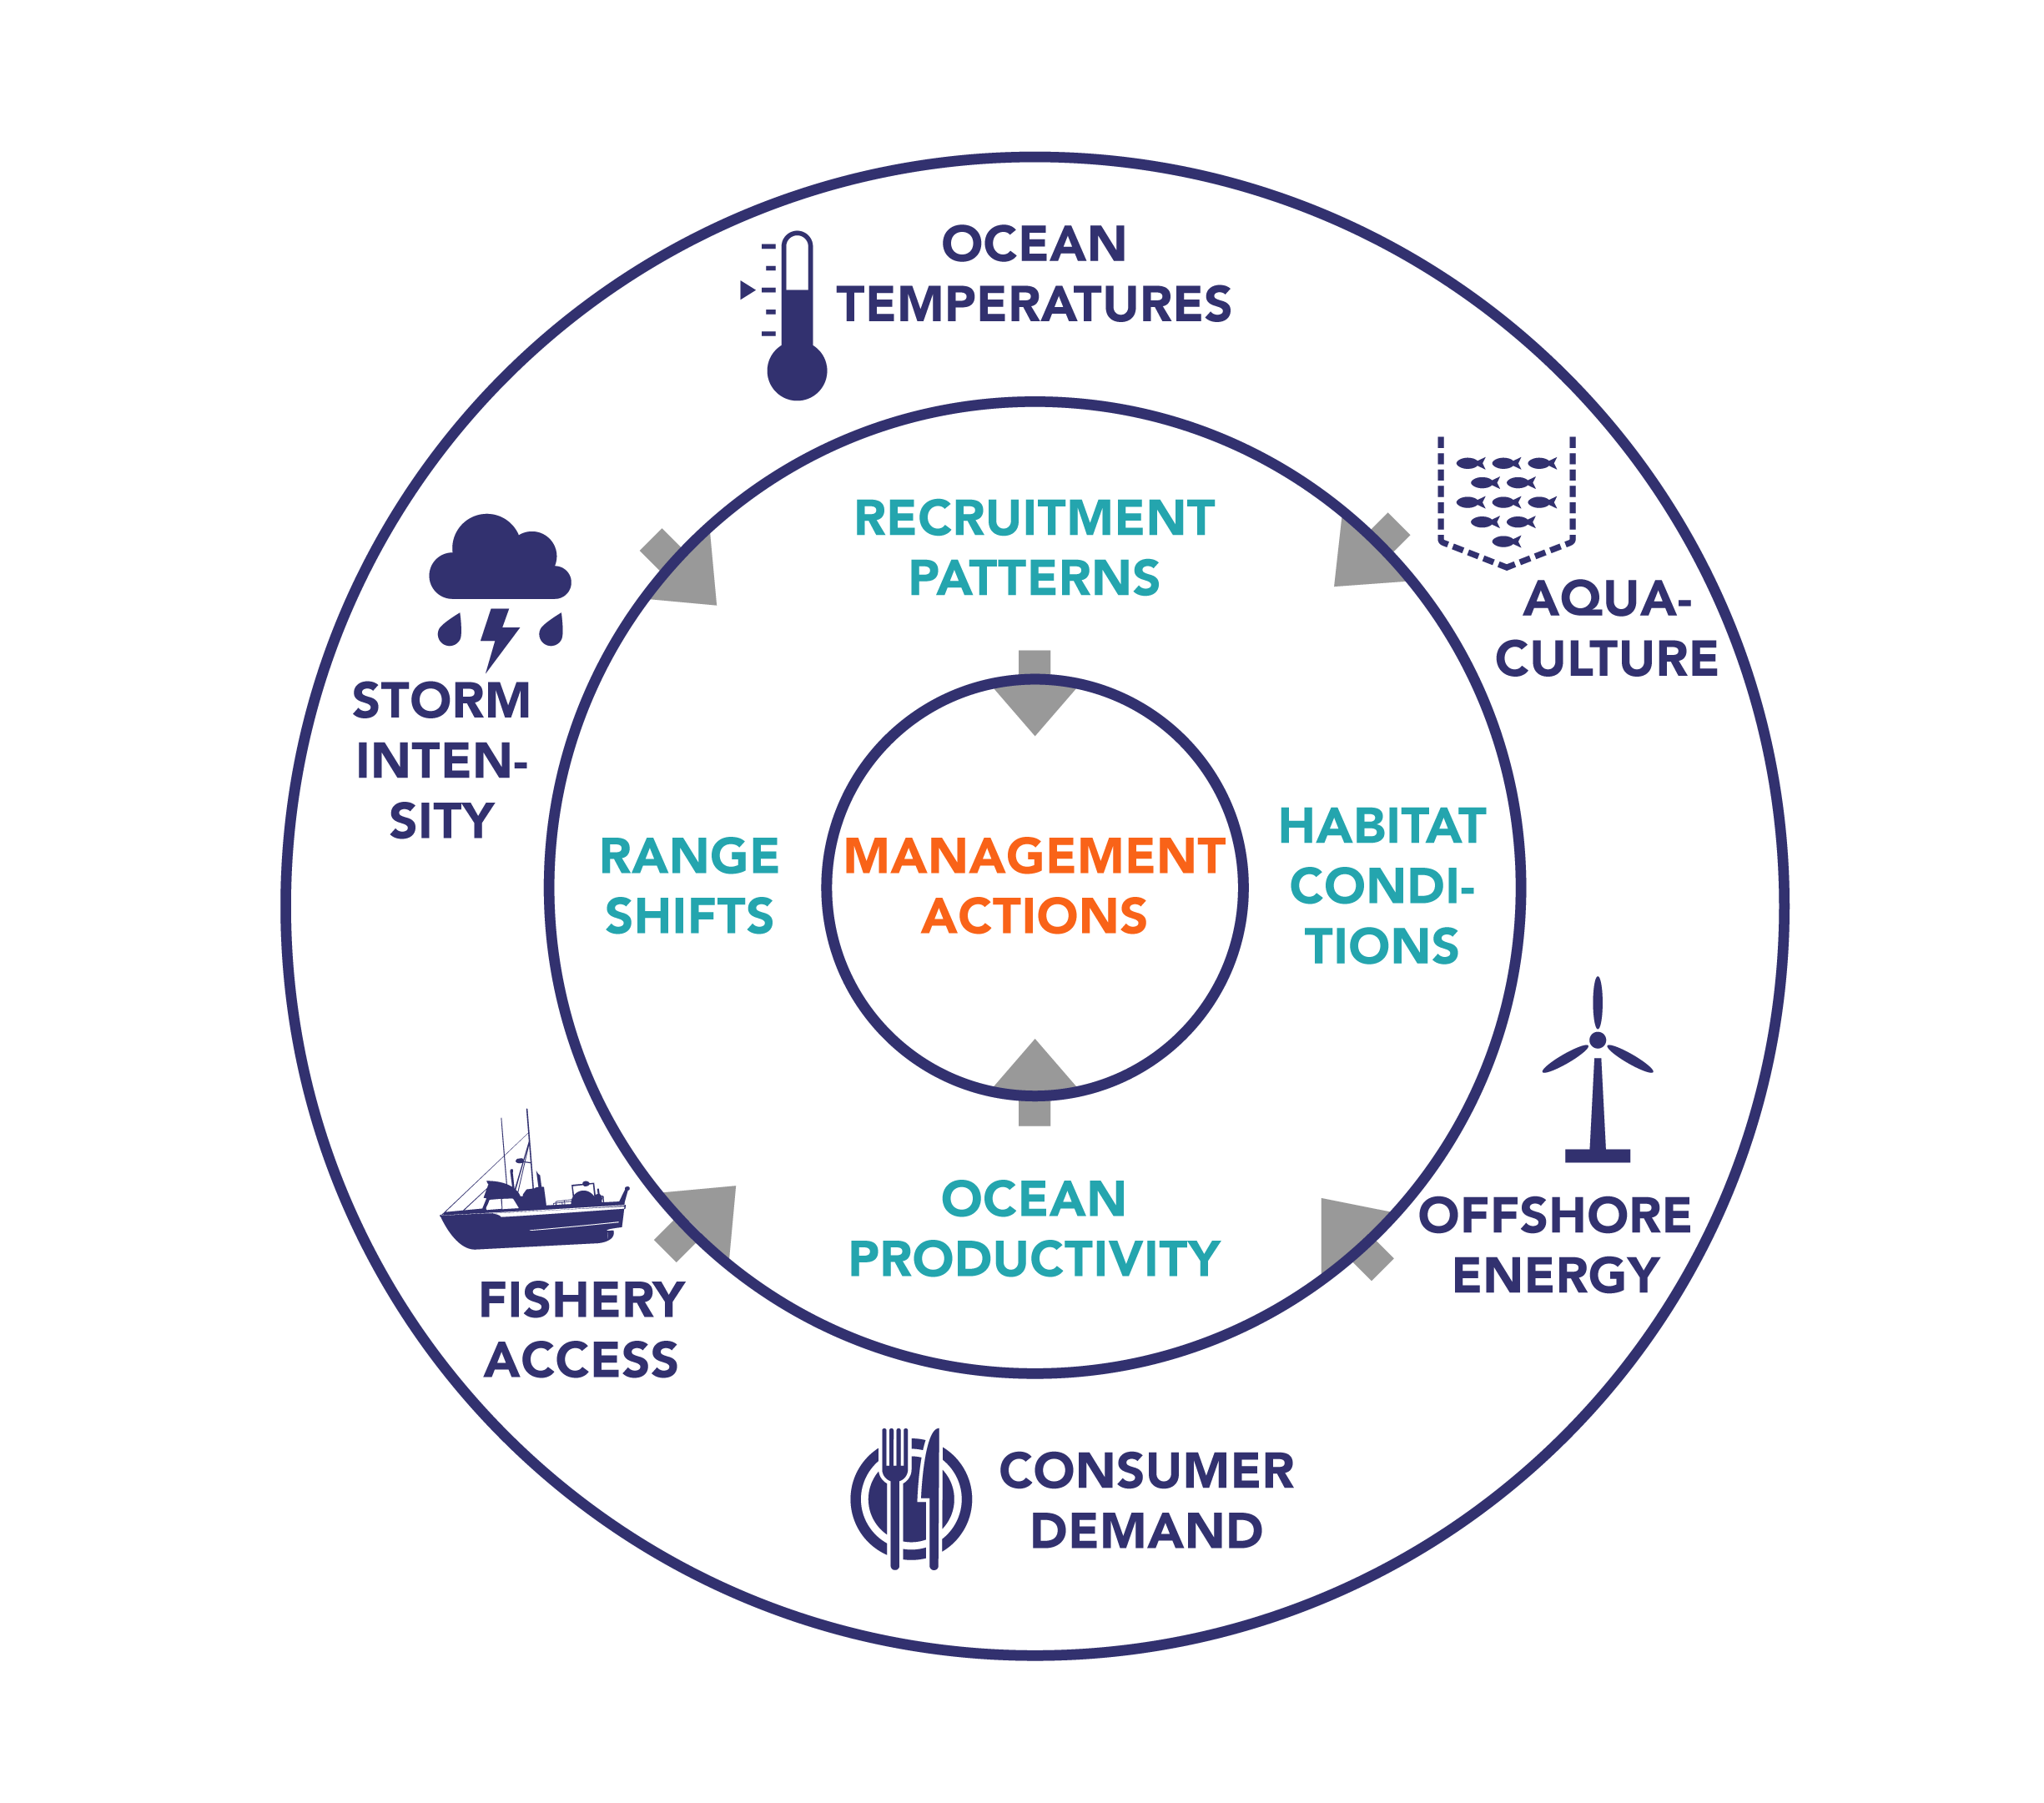
Step 2: Looking Ahead - Outside-In Thinking
Notes:
The next step in creating scenarios is to engage in “looking ahead” at what the future might bring.
In scenarios, it is useful to engage in ‘outside –in thinking’: the broad forces of change such as ocean temperature changes, storm intensity, consumer demand, offshore energy activity have a knock-on effect on habitat conditions, stocks’ range, productivity etc, which in turn will impact the most effective management actions.
This step is all about identifying the forces in the outer and middle circles (not the potential management actions).
IN the ECSP project, we categorized drivers of change into three buckets (i) climate/physical drivers, (ii) biological drivers, and (iii) social and economic drivers

Slide 10
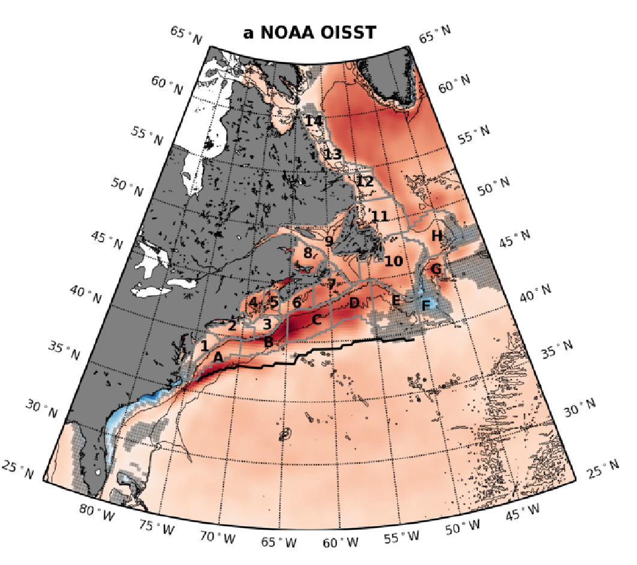
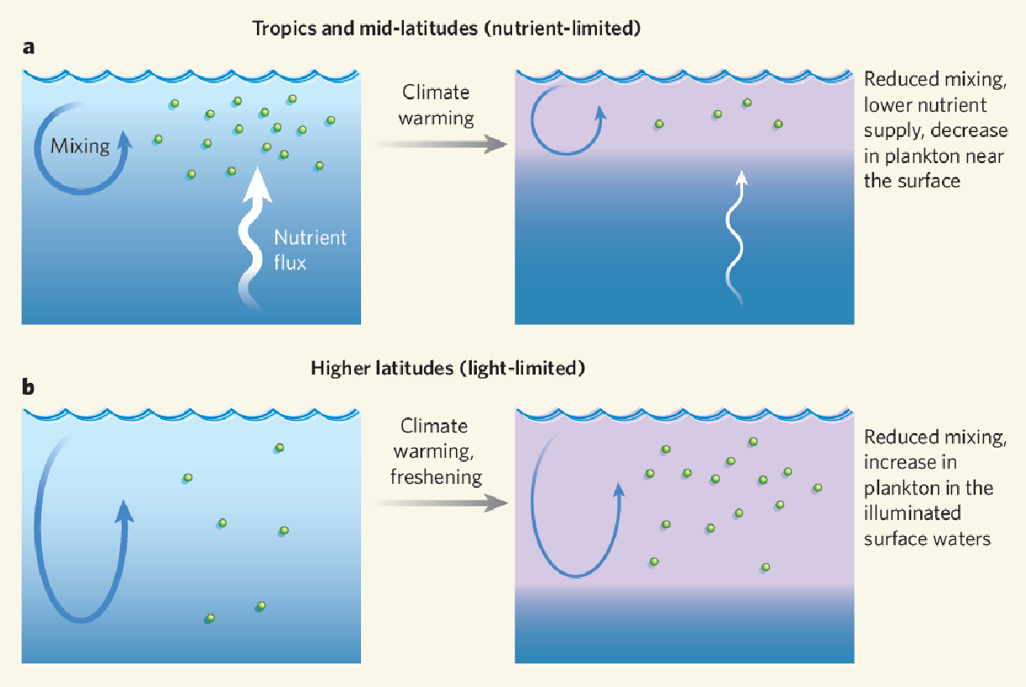
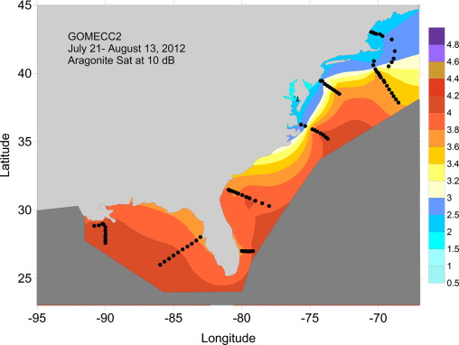
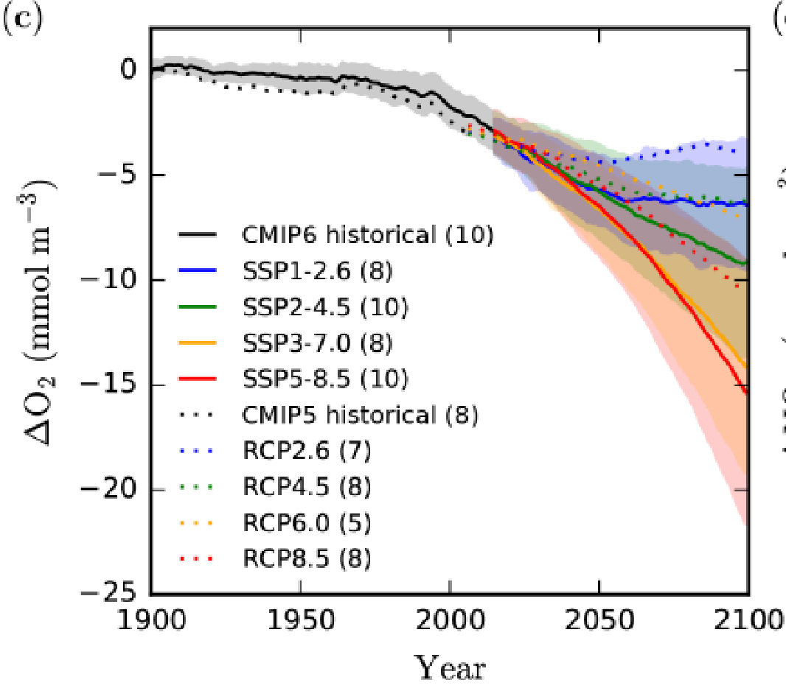
Physical Drivers of Change
Rapid warming across much of the East Coast
Climate change affects net primary production, varies with latitude
ºC per decade
Acidification in upper ocean, but impact on shell formers more connected to water saturation
Warming and stratification lead to widespread oxygen declines
Oceanographic Drivers of Change Webinar Briefing February 2022
Slide extracts from Charlie Stock’s webinar presentation
Notes:
This provides a snapshot summary of some of the main physical / climate drivers that are likely to shape the future of east coast fisheries in the next 20 years.
The ECSP project provided an extensive briefing of these physical / climate drivers in the report linked on this page

Slide 11
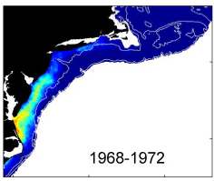
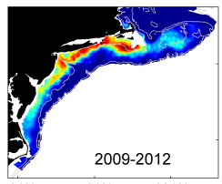
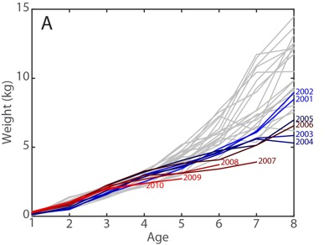
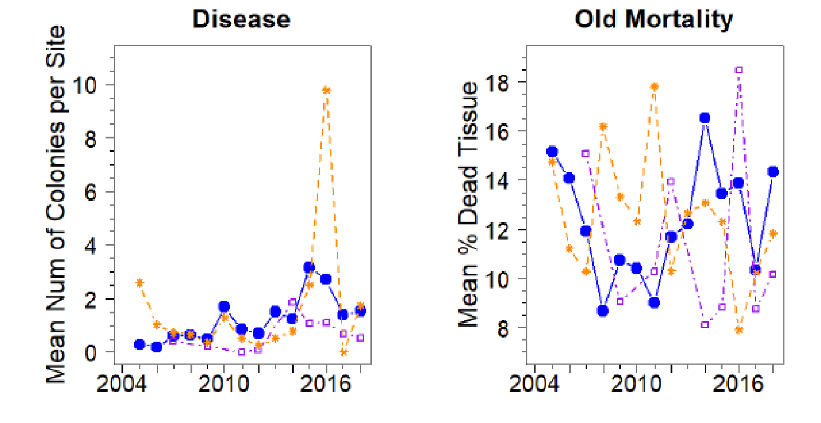
Biological Drivers of Change
Most species have shifted their distribution, often driven by temperature. We’ve also seen changes in migration timing.
Warming has influenced stock productivity, with larger influences on overfished populations. More significant responses in populations with faster life histories. Negative influences of species at the southern end of their range
NOAA NEFSC
Dubik et al. 2019
Many species body sizes getting smaller. Disease becoming more prevalent. Combined effects of warming, acidification and hypoxia can be synergistic.
Biological Drivers of Change Webinar Briefing February 2022
Slide extracts from Janet Nye’s webinar presentation
Notes:
This provides a snapshot summary of some of the main biological drivers that are likely to shape the future of east coast fisheries in the next 20 years. Some of these biological drivers will, in turn, be affected by physical and climate drivers.
The ECSP project provided a briefing of these biological drivers in the report linked on this page

Slide 12
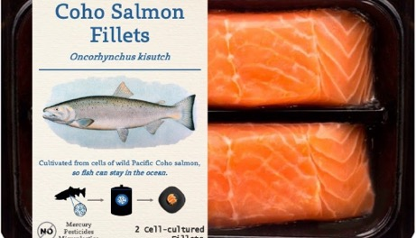
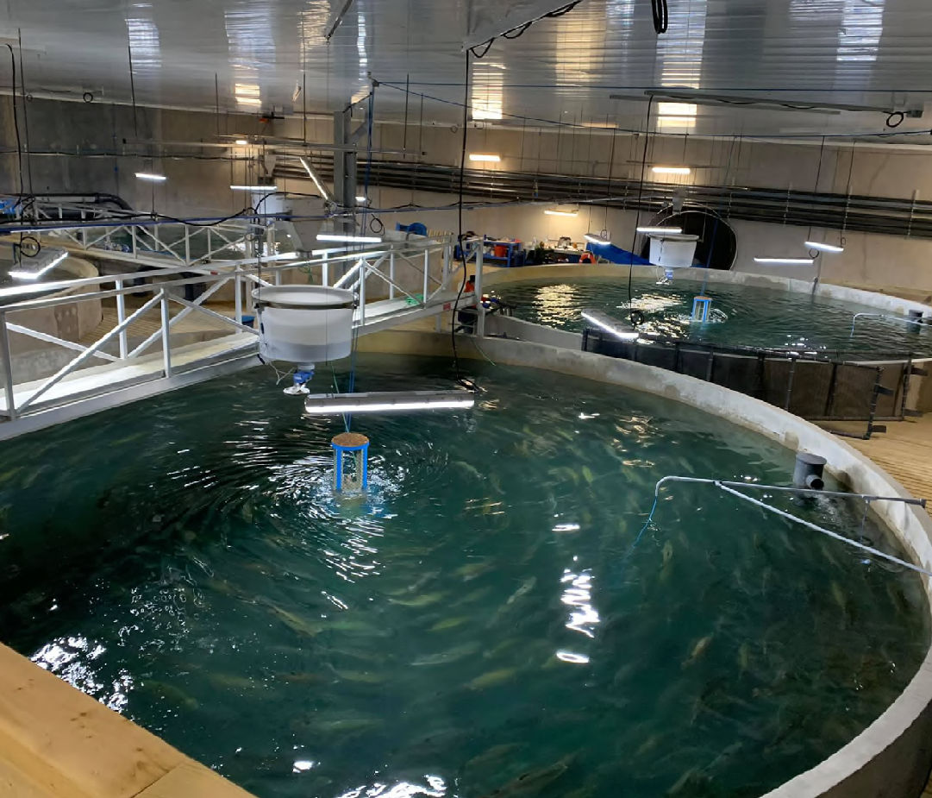
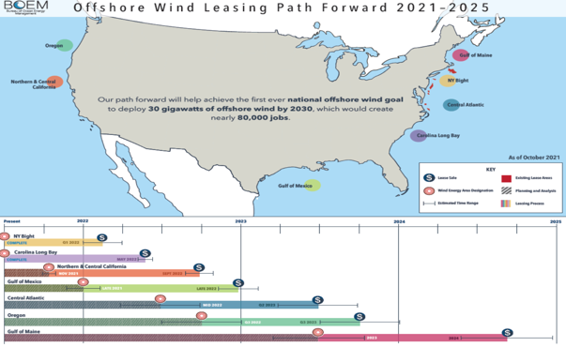
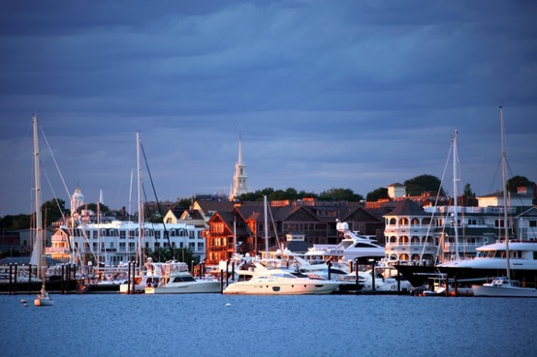
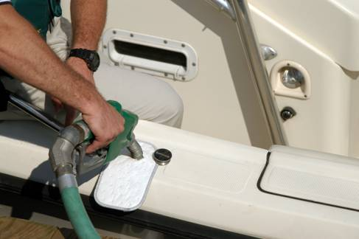
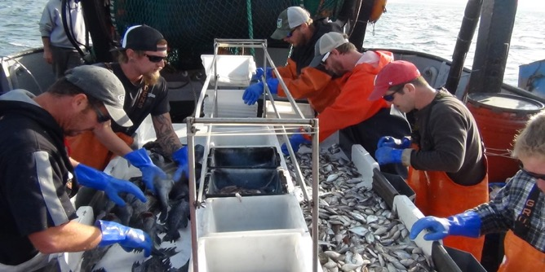
Social & Economic Drivers of Change
Demand / market conditions are shaped by: changing consumer preferences; new technologies creating alternatives to wild-caught / local seafood; international trade / supply chain issues
Fisheries might also be affected by: commercial ocean activity (e.g. offshore wind) ; population growth in coastal towns; demand for scarce waterfront space; various regulations
Fuel costs, crew wages, distances to port, availability of support services likely to affect business viability and ability to adapt to changing conditions
Social & Economic Drivers of Change Webinar Briefing March 2022
Slide extracts from Doug Lipton’s webinar presentation
Notes:
This provides a snapshot summary of some of the main physical / climate drivers that are likely to shape the future of east coast fisheries in the next 20 years.
A summary document on the exploratory phase is available on the initiative’s website.

Slide 13
Step 3: Scenario Building Blocks
Pre-determined Elements
Critical Uncertainties
Wildcards
Factors or forces that are ‘locked-in’ and confidently predictable over the time horizon
Important forces that have the potential to move in alternative directions over the time horizon
Low probability events and developments that could impact the future in significant ways in the time horizon
Notes:
In Step 3, drivers are characterized into one of three categories
Pre-Determined elements – Ocean temperatures continuing to rise, sea level rise, increased alternative ocean uses, and coastal population continuing to grow
Wildcards – Extreme marine heatwaves, harmful algal blooms, extreme market disruptions like a pandemic, and devastating storms
In the middle were critical uncertainties – these were variables that could go either way - either as a minor effect or as a major effect, sometimes in different directions – rates of warming and sea level rise, replacement of species, prevalence of disease, consumer preferences, and extent of costal armoring

Slide 14
Predetermined Elements
Ocean temperatures continue to warm, affecting marine species biology & distribution
Regions exhibit differences in seasonal temperature changes
Primary production changes differently in different regions
Sea levels rise
Changing ocean uses create more competition for fisheries
Coastal population grows
Notes:
These Pre-Determined Elements are important, as they are common features in all of the scenarios that we will create. If they are predictable, then we must prepare for all of these forces in whatever future scenarios we create.

Slide 15
Wildcards
Changes in ocean current systems
Series of extreme marine heatwaves
Series of Harmful Algal Blooms
Regime shifts caused by losses of critical food resource or changes in food web dynamics
Extreme market disruption (e.g. trade war, more pandemics)
Devastating hurricane
Notes:
Wildcards are more extreme or sudden changes that might happen. IT is difficult to make a strategy/plan that assumes that a wildcard will happen – but it is essential to consider a contingency plan to cater for shocks such as this.

Slide 16
Critical Uncertainties
What might happen by 2042? Physical/Climate Uncertainties
Rapid warming in the NW Atlantic | ◀︎ | 1. Rates of ocean warming? | ► | AMOC swings toward a cooler state, stalling warming trend
Major effects | ◀︎ | 2. Impact of saturation of calcium carbonate on shell-formation? | ► | Minor effects
Minor changes | ◀︎ | 3. Extent of changes in the Cold Pool? | ► | Significant reduction in size and duration
Become stronger but less frequent | ◀︎ | 4. Storm frequency and intensity? | ► | Become much stronger and more frequent
Impacts limited to specific locations / times & some positive effects | ◀︎ | 5. Impacts of sea level rise? | ► | Causes significant impacts to many facilities & habitats
Low, decreasing impact | ◀︎ | 6. Pollution & nutrient run-off in estuaries? | ► | High, increasing impact
Notes:
The most important building blocks are critical uncertainties. These usually form the basis of the scenario axes and hence the scenario framework.
For the ECSP scenario creation exercise, we identified 20 different critical uncertainties. They are described in the form of either-or axes, and based around a question of which direction might this go in the next 20 years?
This slide shows the physical / climate uncertainties
SO, uncertainty #1 relates to the degree of warming in Atlantic. In the next 20 years, will we see rapid warming in the NW Atlantic, or will we see an AMOC shift leading to a cooler state? The scenarios will be different depending on which side of the uncertainty is considered. Each of the other critical uncertainties can be described as an either/or outcome in the same way.

Slide 17
Critical Uncertainties
What might happen by 2042? Biological Uncertainties
Varies by species & region – hard to generalize and identify | ◀︎ | 7. Evidence of range expansion / contraction? | ► | More evident, pronounced and consistent
Limited evidence of movement or unpredictable direction | ◀︎ | 8. Direction of species movements? | ► | Mostly northwards / deeper waters
Limited, minor | ◀︎ | 9. Extent of range expansion / contraction? | ► | Extensive, major
Low - species movement is not replaced by other emerging fisheries in the area | ◀︎ | 10. Replacement of moving species? | ► | High - most species movement is replaced by other emerging fisheries in the area
Mostly maintained, worst effects on overfished populations | ◀︎ | 11. Stock production? | ► | Declines markedly across many populations
Maintained / as now | ◀︎ | 12. Disease prevalence? | ► | Much higher
Low | ◀︎ | 13. Extent of predation on key species? | ► | High
Minor, occasional, generally manageable impacts | ◀︎ | 14. Impact of fishery interactions with protected resources or choke species? | ► | Major, ongoing impacts
Notes:
This slide shows the biological uncertainties

Slide 18
Critical Uncertainties
What might happen by 2042? Social & Economic Uncertainties
Moderate tech advances, used by few | ◀︎ | 15. Development and use of technology to support fisheries? | ► | Widely available, used extensively (e.g. gear, tracking, vessels etc.)
Declining market and lower prices as market is saturated / highly competitive (e.g. aquaculture, lab-grown fish) | ◀︎ | 16. Consumer preferences for wild caught and local seafood? | ► | Growing market and higher prices as wild caught / local becomes a premium market
Marginal or positive effects on species distributions / research efforts etc. | ◀︎ | 17. Impact of offshore wind installations? | ► | Mostly damaging effects on species distributions / research efforts etc.
Costs are contained creating profitable opportunities for most | ◀︎ | 18. Fishing & related industry viability? | ► | Costs rise more quickly than revenues for most operators
Limited coastal armoring as ‘living shoreline’ alternatives become popular | ◀︎ | 19. Extent and impact of coastal armoring? | ► | Significant, with widespread effect on habitats
Leads to damaging competition and less prosperous fishing communities | ◀︎ | 20. Impact of alternative ocean uses, other coastal developments on fishing communities? | ► | Leads to more prosperous coastal and fishing communities
Notes:
This slide shows the social and economic uncertainties.
Taken together, these 20 uncertainties were represented on two-sided cards. 8 breakout teams used different combinations of cards to create 3 scenario stories each. This resulted in 24 mini-scenarios.

Slide 19
Key Uncertainties
Stock production/
Habitat/
Replacement species
Declining
Stock production/
Habitat/
Replacement species
Maintained
Levels/health of stock productivity
Patterns of distribution
Regional
Coast-wide
Patterns of distribution etc.
Mostly predictable
Unpredictable
Science ability to assess change
Adequate / improving
Limited / unable to cope
Industry / Player Adaptability
Mostly Low
Mostly High
Notes:
Obviously 24 was too many scenarios to use effectively. Useful scenario planning is done with 3-5 stories that are related to one another. This is done by identifying key uncertainties and then crossing them to form a quadrant of possibilities. Using the mini-scenarios and the insights we gleamed, we identified several key uncertainties.
The first spoke to the state of the ecosystem. Whether there is a strong, healthy ecosystem state with productive stocks, replacement of species, and adequate habitat. We recognize that there will be winners and losers no matter which end of the spectrum you are on. We are characterizing the overall ecosystem and not any one particular stock.
Next there was a group of uncertainties that centered around how predictable the system appears to be. Whether that is by extreme regional differences, how the species are responding, and if science is able to figure it out or not.
We also recognized that the ability of the industry/individual players to adapt will also be a major factor in the future.

Slide 20
Step 4: Scenario Framework
Notes:
We settled on using two core, critical uncertainties.
One (vertical axis) relates to the health of the ecosystem, and specifically stock production and replacement. Are stocks maintained / increasing or decreasing?
The other relates to the unpredictability or ocean and stock conditions. Will conditions be highly unpredictable, so that science lacks an ability to assess? Or will conditions be somewhat predictable, so that science can assess and assist fishery management?
Crossing these uncertainties gives us four quadrants, each with distinctive features.

Slide 21
Step 4: Scenario Framework
Mostly maintained
Ocean Pioneers
Checks & Balance
Unpredictable changes & conditions, low ability to assess
Predictable changes & conditions, high ability to assess
Predictability of conditions /
ability of science to assess by 2040
Stock productivity & replacement
Compound Stress Fractures
Sweet & Sour
Mostly declining
Notes:
More detail was added to the four basic scenarios, and each was given a title that captured some important aspect of that future:
Ocean Pioneers is a scenario about a ‘wild west’ environment, where high uncertainty and high reward creates conditions ripe for new entrepreneurial activity
Compound Stress Fractures is a scenario where climate change has damaging impacts on fisheries and the ability to manage them, creating a low-trust world
Sweet & Sour tells the story where the science is good but the news is bad. Ocean conditions deteriorate; scientists are able to track this, but future problems are stored up
Checks and Balance is a scenario where fisheries and coastal communities mostly cope with climate change, in part because of advances in scientific assessment

Slide 22
Step 5: Scenario Details - Criteria for Good Scenarios
Plausible
each scenario has the potential to occur (even if the assessed probability is low)
Challenging
to most peoples’ current conventional wisdom
Memorable
the main concept behind each scenario story is powerful and relatively easy to communicate
Divergent
the scenarios are clearly different from each other, helping “stretch” thinking in different directions
Relevant
to the challenge outlined in the scoping phase
Notes:
The next step is to provide more details for each of the scenario quadrants. In creating storylines and logics for each, it is important to consider the criteria for effective scenarios. Here are 5 elements to strive for:
Is each scenario plausible?
Is each scenario challenging?
Is each scenario relevant?
Is each scenario memorable?
Taken together, are the scenarios divergent?

Slide 23
Step 5: Scenario Details
Ocean Pioneers
Crazy ocean conditions & weird weather: pendulum swings, boom & busts
Ocean is resilient –stocks are maintained (in aggregate) with no damaging climate tipping points
Seasons and locations of traditional fisheries change unpredictably, leading to (e.g.) changes in interactions with protected species
Traditional stock assessments are less reliable; real-time data from vessels and other users is more valuable than traditional science
New assessment approaches generate questions over data rights and data aggregation
Extreme weather often creates dangerous fishing conditions
Ocean activity (fishing, aquaculture and offshore wind) dominated by entrepreneurs, technology, pioneers
Winners typically have deep pockets, sharp elbows, new technology and a willingness to take risks
Uncertainty about how long “abundant” stocks can keep delivering
Notes:
This provides some of the main features of this scenario:

Slide 24
Step 5: Scenario Details
Compound Stress Fractures
Unpredictable conditions create climate tipping points with negative impacts to diverse harvest, forage and marine wildlife species
Storms and population growth create more pollution, reducing the quantity and quality of estuaries and other nearshore habitat
Diseases are prevalent – several marine heatwaves lead to die-offs
High stress on fishing operators: costs rise and harvest opportunities are reduced due to low abundance of traditional stocks and new area closures to protect endangered species
Science appears unable to help the fishery management community adapt; stock assessments rely on insufficient data and constant lawsuits drain management capacity
Stocks experiencing range shifts are incorrectly classified as overfished; these mistakes undermine the management process
Low levels of trust between several different stakeholder groups
Conditions require operators to shift effort to lower trophic level species
Government steps in to save some domestic fisheries, but only a few select fisheries get assistance
Fishing no longer the dominant activity in the ocean, competing with other industries for space and attention

Slide 25
Step 5: Scenario Details
Sweet & Sour Seafood
“Science is good, but the news is bad”
Declining productivity and abundance for many species including harvest mainstays, choke species, and diverse marine wildlife; maximum fish size is smaller
The cold pool continues to shrink in size and duration, negatively impacting diverse species that depend on this pelagic habitat
Range shifts as species move N and E, but not much range expansion
In some regions, management puts limits on newly arriving species, allowing establishment of new reproducing populations; marine wildlife interaction/bycatch challenges are addressed through improved forecasts and fishing community innovation
Successful small-scale fishermen adapt to reduced catch limits and new stocks, supplying limited but lucrative markets
Unsuccessful regions struggle to develop effective responses to challenges like shifting stocks and new marine mammal interactions, leading to fleet consolidation, loss of markets to artificially cheap seafood imports, and the permanent decline of historic fishing communities.
Aquaculture becomes prevalent as a mass source of seafood

Slide 26
Step 5: Scenario Details
Checks and Balance
Predictable changes and tolerable conditions; sea levels rise gradually
Range expansion as stocks move predictably north & east
Climate mitigation efforts reduce greenhouse gas emissions, with little effect on ocean conditions in the short-term; however, better pollution reduction, habitat protection and restoration reverse a great deal of habitat damage and loss
Science capacity booms, delivering effective ocean monitoring, real-time catch reporting, food web/population monitoring and bycatch avoidance
Species composition has changed, but widespread data means that management can provide for a full and flexible balanced use of available fish stocks
Investment in other ocean/coastal uses leads to competition (e.g. aquaculture) and collaboration (e.g. fisheries science is boosted by wind energy installations)
Recreational sector is healthy thanks to stable productivity and increased coastal wealth, but gentrification creates concerns over accessibility

Slide 27
Steps 5 & 6: Implications and Options
What might conditions be like in 2042?
SCENARIOS
What challenges and opportunities does this scenario create?
IMPLICATIONS
What changes / actions should happen now to prepare for future conditions like this?
OPTIONS
Notes:
Once the scenarios are created, they can now be used to help generate ideas.
First, groups should imagine each scenario in turn, and consider what the biggest challenges or opportunities that type of future might create. Because it’s climate change, we might expect more challenges than opportunities, but it’s important to consider both
Then, you can follow with conversations about “what to do” if you are expecting that scenario to play out in future. What are the actions needed to prepare for it?

Slide 28
Steps 5 & 6: Customized Implication Conversations
Implications conversations can be customized for specific audiences, for example:
Commercial fishermen
Recreational fishermen
Coastal communities
Fishery managers
Alternative energy providers
Aquaculture businesses
Or for specific roles, for example:
harbormasters,
charter businesses,
tourism providers,
local policy-makers
They can also be customized for specific regions or geographies
What are the main opportunities for [aquaculture] in this scenario?
What are the main challenges facing [recreational fishermen] in this scenario?
What types of fishery stakeholder is successful in this scenario? What qualities and resources bring success?
What types of fishery stakeholder struggles in this scenario? What are the prime causes of failure?
Notes:
Implications conversations can be designed to be relevant for specific participants. There are many ways to ask questions that help reveal ideas about challenges, opportunities and reasons for success/failure.

Slide 29
Step 6: Some suggested prompt questions – for options
For each scenario, given the challenges and opportunities,…
What new practices would you need to learn and apply?
What new investments would you make?
What types of skills / experience would you need to develop or recruit for?
What new markets or customers would you serve?
What existing practices should you stop doing?
What new relationships would you build?
What new information would you need to acquire?
What changes in policies or regulations would you want to see?
Notes:
Sometimes, it is straightforward to just to ask a group: what would we do in this scenario?
But often, it is good to be more specific about the questions. This slide provides some examples of questions that can get at specific actions for groups.

Slide 30
Step 6: ‘Placing Bets’ Across A Scenario Matrix
ROBUST: Pursue those options that would work out well (or at least not hurt you too much) in any of the four scenarios
HEDGE: Make several distinct bets of relatively equal size, then wait and see what happens
BET THE FARM/VISIONING: Make one clear bet that a certain future will happen — and then do everything you can to help make that scenario a reality
CORE/SATELLITE: Place one major bet, with one or more small bets as a hedge against uncertainty (experiments)
EXTREMES: Prepare for, or prevent, a worst-case scenario
BET THE FARM / VISION
CORE
HEDGE
HEDGE
ROBUST
HEDGE
HEDGE
SATELLITE
SATELLITE
EXTREMES
Notes:
The previous slides encourage groups to generate ideas to help prepare for each different scenario. It is likely that there will be more ideas that the organization can cope with. How should a group prioritize the most important ones, and create a coherent approach to deal with climate change (or other factors?)
This slides shows various types of strategic approach that organizations can adopt:
The most common approach is to identify some robust or ‘no-regret’ options that will work across multiple scenarios.
Often it is also helpful for groups to identify some actions that will help prevent a worst-case scenario, or maybe drive them towards a more preferred scenario.
In some instances, an organization might recognize that their scenario needs to be flexible to cope with future uncertainty. That’s when the best approach might be to hedge, or to adopt some kind of core/satellite approach. These approaches require that the organization keeps track of changes, to see if conditions are moving from one scenario to another.

Slide 31
Fishery Managers were concerned with…
Ocean Pioneers
Checks & Balance
2. Managing Under Increased Uncertainty
1. Cross-Jurisdictional Governance
3. Data sources and partnerships
Unpredictable changes & conditions, low ability to assess
Predictable changes & conditions, high ability to assess
Compound Stress Fractures
Sweet & Sour
Notes:
In the ECSP project, through a series of conversations at Council and Commission meetings, groups identified three broad areas that they wanted to dig into more deeply.
The first was cross-jurisdictional governance. This was a “robust option” – we can expect that stocks will shift across jurisdictional boundaries in every scenario, so paying close attention and identifying actions to deal with governance challenges was identified as a real priority.
The second was managing under increased uncertainty. This set of issues will be particularly relevant in scenarios on the left-hand side where climate causes high unpredictability and where scientific information about conditions is limited. How can fishery managers work more effectively in situations of high uncertainty? This set of changes becomes another priority.
The third was data sources and partnerships. Making progress around these issues will help shift our world from left to right….better data and collaboration will mean that science offers a better chance for fishery managers to understand stocks and ocean conditions, and make better decisions as a result.

Slide 32
More detailed decisions follow from there
Cross-jurisdictional Governance
Managing under Uncertainty
Data Sources and Partnerships
Reevaluate Council committee structure, use, and decision making
Identify ecosystem-level contextual information that can be considered within the management process to help incorporate climate information into decisions
Expand study fleet, include recreational fisheries, and ensure data are used
Use survey mitigation around offshore wind to transition to industry-based surveys or other survey platforms
Re-evaluate and potentially revise Advisory Panel representation
Streamline FMP documentation and rulemaking
Develop joint management agreements with aim of clarifying roles and increasing efficiency
Improve the use of existing data.
Improve coordination across NOAA offices and regions
Notes:
The last stages of the ECSP project encouraged decision-makers to identify specific actions in each of these three areas. This provides a selection of ideas that will be taken forward in the coming months and years.

Slide 33
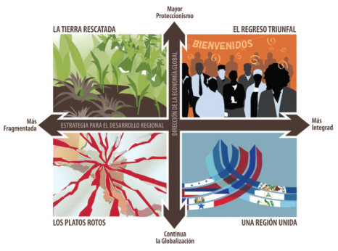
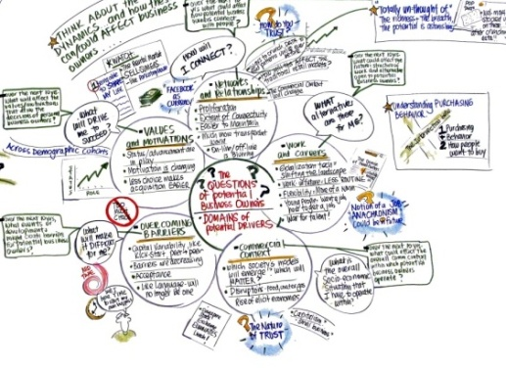
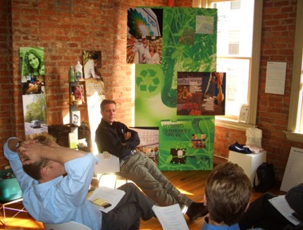
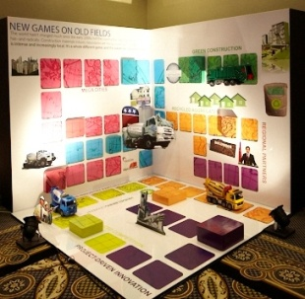
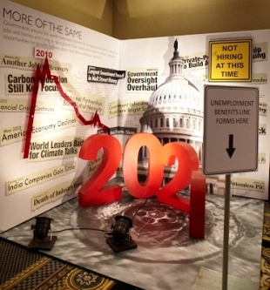
Step 7: Communicating Scenarios
Notes:
Once a scenario project has been completed, organizations will often see value in communicating the findings to others – often internally within the organization, but also to other external audiences. Sometimes this is because the scenarios can help deliver important messages about risks, opportunities and future actions. At other times, the scenarios are communicated because they provide a good platform for engagement and ongoing conversations with partners, so that all parties can benefit from a new perspective on the future.
Scenarios are usually communicated in written reports or powerpoint decks. But there are many ways to bring scenarios more to life using imagery, graphic recording, installations and scenario-themed rooms. The purpose is to communicate the scenarios and ideas as vividly as possible, so that participants can envisage being in each future.

Slide 34
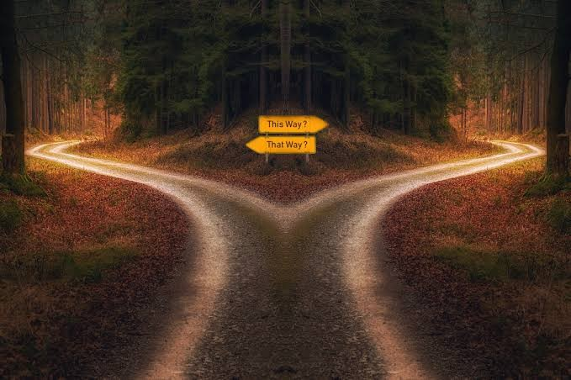
Step 7: Continuing Scenario Conversations
It is worth returning to the scenario framework at regular intervals following a scenario project. This can be done to address two separate goals.
First, periodically (e.g., annually) assessing the current state of conditions is useful for tracking change and determining if conditions are moving toward an identified scenario or in an unexpected direction.
Second, the scenarios can be used as a “wind tunnel” to assess how different management options being considered in a regulation could play out across the already identified plausible future scenarios.
Notes:
It is often important to continue strategy conversations after a scenario project, in order to ensure that the strategy stays relevant as external conditions change. This means monitoring the external environment to see if we are moving from one scenario to another.
For ECSP, monitoring will mean looking closely at changing ocean and stock conditions, through data contained in publications such as State of the Ecosystem reports. As new evidence emerges, does this mean that new actions need to be considered, or existing practices changed in some ways? Or maybe some actions that were not prioritized in 2023 might become more feasible / worthy of consideration at a later date.
It is important to schedule a regular time to check in about changes. This might be a six-monthly or annual revisiting of the scenarios and the action plan that results.

Slide 35
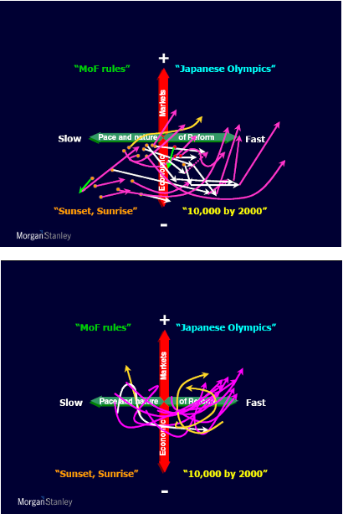
Continuing Scenario Conversations - Tracking Change
On a regular basis, groups should discuss whether conditions have changed, and whether a different or new scenario should now be considered
To do this, groups should track “indicators” - key developments and dynamics in the external environment that suggest that a particular scenario seems to be unfolding in the real world
For the ECSP scenarios, this will mean looking closely at evidence for changing ocean and stock conditions. As new evidence emerges about changing conditions, groups should consider if new actions are needed, or if existing practices should be changed. Maybe actions that were not prioritized in 2023 become more relevant in later years?
Continuing such conversations ensures that a plan remains flexible against changing conditions
Managers decide and plot which way they think scenario trends are headed. This example taken from HBS Case Study: Morgan Stanley Japan, 2002.
Notes:
It is often important to continue strategy conversations after a scenario project, in order to ensure that the strategy stays relevant as external conditions change. This means monitoring the external environment to see if we are moving from one scenario to another.
For ECSP, monitoring will mean looking closely at changing ocean and stock conditions, through data contained in publications such as State of the Ecosystem reports. As new evidence emerges, does this mean that new actions need to be considered, or existing practices changed in some ways? Or maybe some actions that were not prioritized in 2023 might become more feasible / worthy of consideration at a later date.
It is important to schedule a regular time to check in about changes. This might be a six-monthly or annual revisiting of the scenarios and the action plan that results.

Slide 36
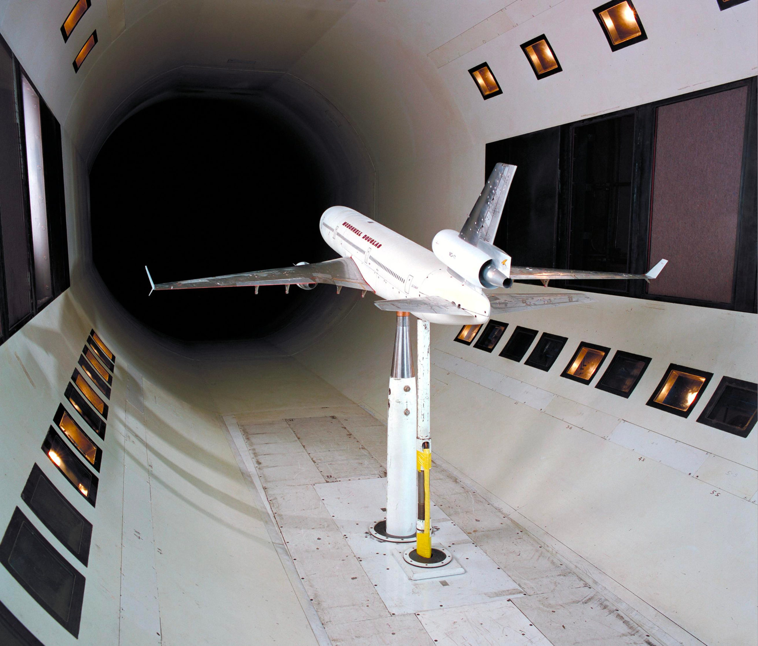
Continuing Scenario Conversations - Wind Tunneling
When new regulations are being considered, groups should discuss how the alternatives being considered would play out in the existing scenarios.
Potential questions to ask are:
Are there management alternatives that would be more successful in the existing scenarios than others? Re-look at the Step 6 slide on “placing bets” (see slide 30)
Do any management alternatives represent a robust opportunity?
Do any management alternatives represent a “bet the farm” option?
Do any management alternatives help us prepare for, or prevent, a worst case scenario?
Do any of the management alternatives limit or increase future management adaptability?
Do any of the management alternatives limit or increase the adaptability of the fishermen, fishing businesses, or fishing communities?
Notes:
It is often important to continue strategy conversations after a scenario project, in order to ensure that the strategy stays relevant as external conditions change. This means monitoring the external environment to see if we are moving from one scenario to another.
For ECSP, monitoring will mean looking closely at changing ocean and stock conditions, through data contained in publications such as State of the Ecosystem reports. As new evidence emerges, does this mean that new actions need to be considered, or existing practices changed in some ways? Or maybe some actions that were not prioritized in 2023 might become more feasible / worthy of consideration at a later date.
It is important to schedule a regular time to check in about changes. This might be a six-monthly or annual revisiting of the scenarios and the action plan that results.

Slide 37
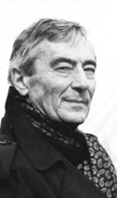
For more information on the ECSP project, or for more resources on
scenario planning, please visit
https://www.mafmc.org/climate-change-scenario-planning
“Scenarios are stories. They are works of art rather than scientific analyses. The precision of [their content] is less important than the types of conversations and decisions they spark.”
Arie de Geus, The Living Company
De Geus is a former corporate planning director for Royal Dutch Shell. Shell pioneered the application of scenario planning to the business world.

Slide 38
Links to Additional Toolkit Materials
Designed worksheets (scenario creation, idea generation)
Timed agendas for scenario discussions (various durations)
Guidelines for scenario small group facilitators
Language for scenario ground rules and session expectations
Description of alternative scenario creation approaches
Suggestions for ongoing ‘monitoring’ conversations

