Slide 1
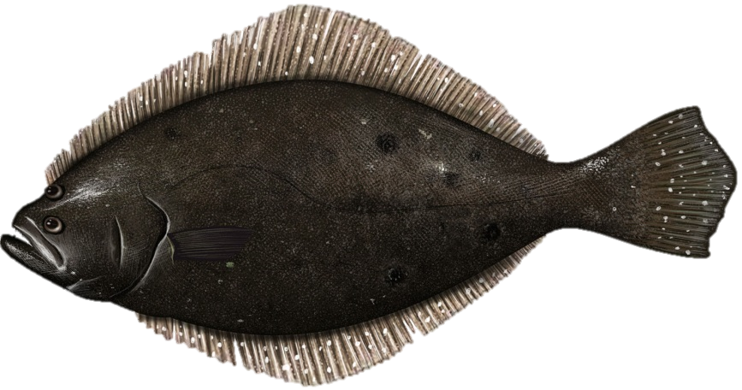
Summer Flounder
Review of 2015 Management Measures
August 13, 2014

Slide 2
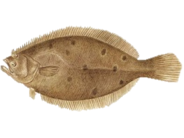
Overview
Last year: 2014-2015 specifications set for summer flounder
Review fishery performance
Review implemented 2015 specifications

Slide 3
Timeline
July 1: Advisory Panel meets to develop Fishery Performance Reports
July 23: SSC meets to review ABC recommendations
July 25: Monitoring Committee webinar to review ACTs and management measures

Slide 4
Stock Status
2013 benchmark stock assessment (SAW/SARC 57)
age-structured assessment program (ASAP)
Not overfished and overfishing not occurring in 2012
2014 data update (landings, discards, and survey indices)

Slide 5
Fishing Mortality
2012 F = 0.285
Below F_{35%}= F_{MSYproxy}= 0.309

Slide 6
Biomass
2012 SSB = 113.0 mil lb (51,238 mt)
~82% of SSB_{MSY} = 137.6 mil lb (62,394 mt )

Slide 7
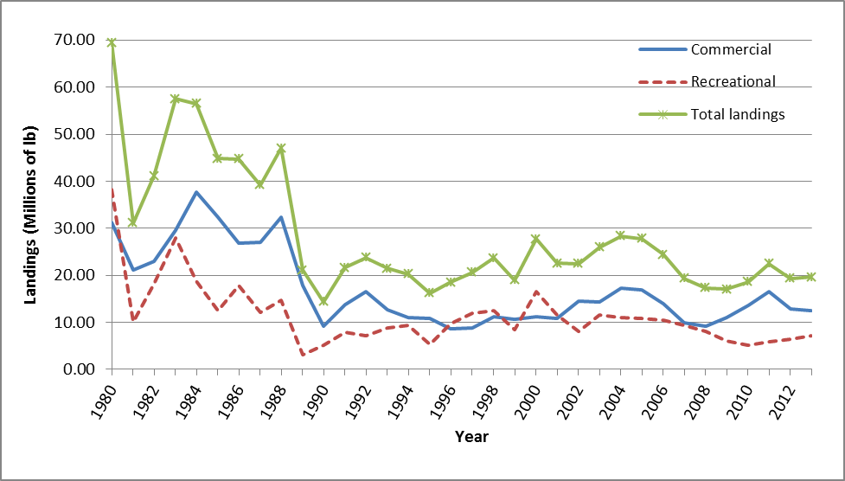
Landings

Slide 8
Fishery Performance
Commercial
Year | Comm. Landings | Comm. quota | % over/ under
2012 | 12.91 | 12.73 | +1%
2013 | 12.49 | 11.44 | +9%
Recreational
Year | Rec. landings | RHL | % over/ under
2012 | 6.49 | 8.49 | -24%
2013 | 7.01 | 7.63 | -8%

Slide 9
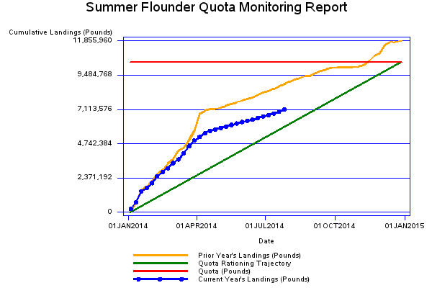
Quota Report for week ending 7/26/14
68% of commercial quota harvested as of week ending July 26

Slide 10
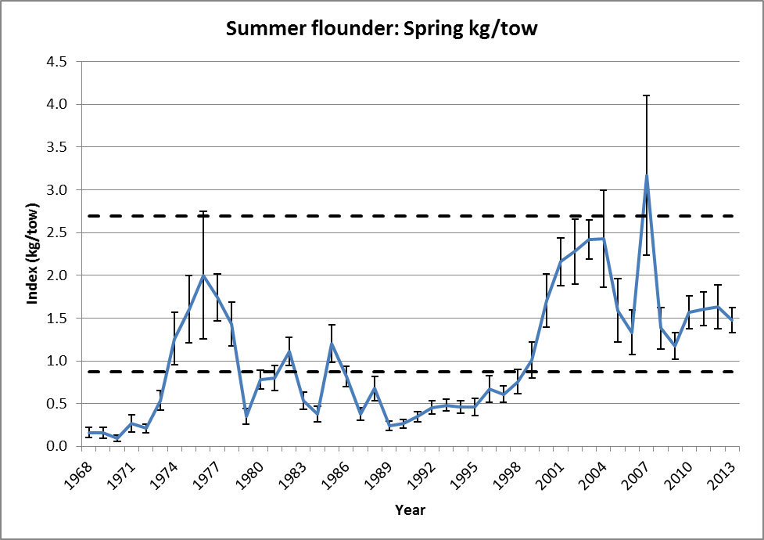
Data Update

Slide 11
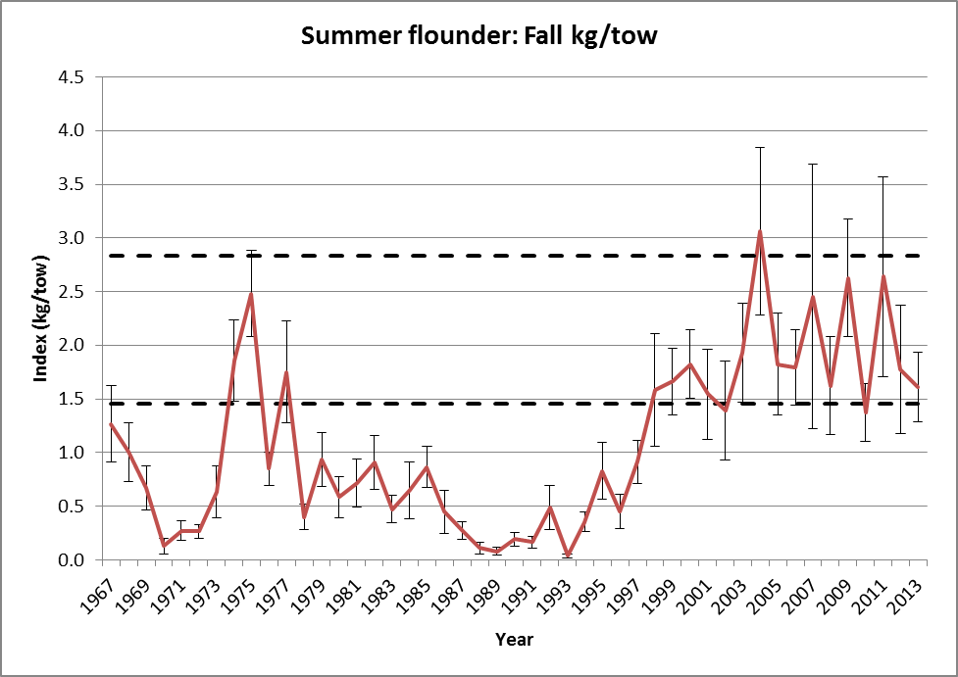
Data Update

Slide 12
Data Update

Slide 13
AP Fishery Performance Report
Lack of confidence in MRIP estimates
Believe recent effort reductions not captured by outdated effort surveys
New effort methodology should be implemented immediately
Have seen recreational effort shifts by state due to regional conservation equivalency regs.

Slide 14
AP Fishery Performance Report
Concern about high size limits resulting in high fishing pressure on large females
Closure of Oregon Inlet drastically affecting commercial landings in NC
Commercial effort shifts away from southern states due to management measures (TED requirements in NC)

Slide 15
AP Fishery Performance Report
Research plan comments:
Research into different hook types to reduce recreational discard mortality
Explore uses of smartphone applications/other technology for voluntary angler surveys

Slide 16
Regulatory Review
September 2013 SSC review (benchmark stock assessment)
Level 3 assessment designation
2014-2016 ABC recommendations based on stock projections and Council risk policy (see staff memo)
Council and Board: 2014-2015 ABC recommendation

Slide 17
Staff Recommendation: No Change to Implemented Specifications
 | 2014 | 2015
ABC | 21.94 mil lb (9,950 mt) | 22.77 mil lb (10,329 mt)
Commercial ACL = ACT | 12.87 mil lb (5,837 mt) | 13.34 mil lb (6,049 mt)
Recreational ACL = ACT | 9.07 mil lb (4,113 mt) | 9.44 mil lb (4,280 mt)

Slide 18
Staff Recommendation: No Change to Implemented Specifications
With 0% RSA:
 | 2014 | 2015
Commercial quota | 10.51 mil lb | 11.07 mil lb
Recreational Harvest Limit | 7.01 mil lb | 7.38 mil lb

Slide 19
Staff Recommendation
No changes to 2015 Annual Catch Targets (ACTs), commercial minimum fish size (14-inch total length), gear requirements, or exemption programs

Slide 20
SSC
No compelling evidence to warrant a change to the recommended 2015 ABC

Slide 21
Monitoring Committee
No recommended changes to 2015 ACTs or management measures

Slide 22
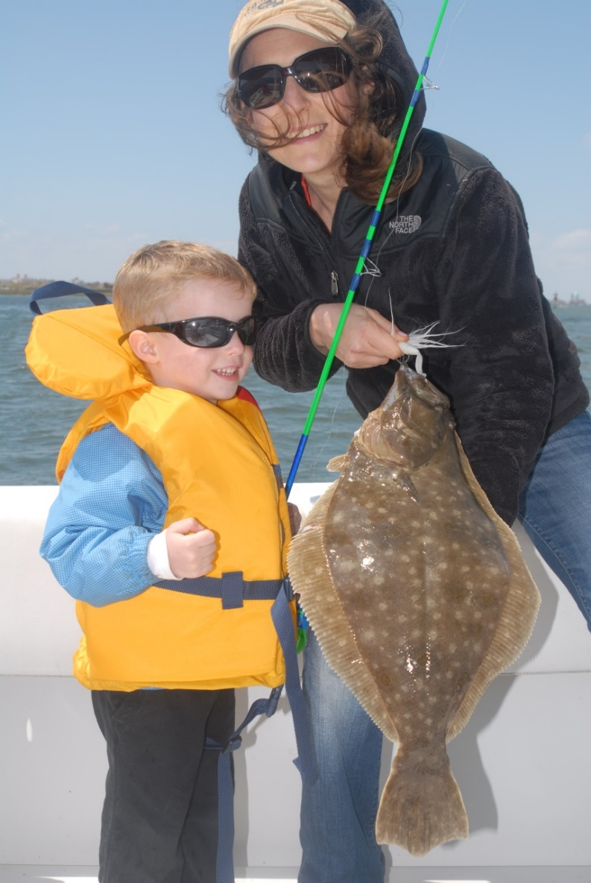
Questions?

